Slide 1
Identity and Access Management (IAM) – AWS
Abdul Rasheed Feroz Khan
Director – CodeSizzler
feroz@codesizzler.info

Slide 2
Topics:
What is IAM?
Components of IAM
Audit scenarios with IAM
AWS CloudTrail

Slide 3
IAM??
Identity and Access Management helps you to provide the access control to – interact with AWS services and resources

Slide 4
Components:
IAM Users – Create individual users
IAM Groups – Manage permissions with groups
IAM Roles – use roles for EC2 instances
IAM Policies – setup default or customised policies
IAM Permissions – Grant least permissions
IAM Audit - AWS CloudTrail
IAM Password – Configure a strong password policy
IAM MFA – Multi Factor Authentication

Slide 5
Components (cont.):
IAM Sharing – Use IAM roles to share access
IAM Rotate – Rotate security credentials regulary
Conditions – Restrict access with conditions
Root – reduce or remove use of root

Slide 6
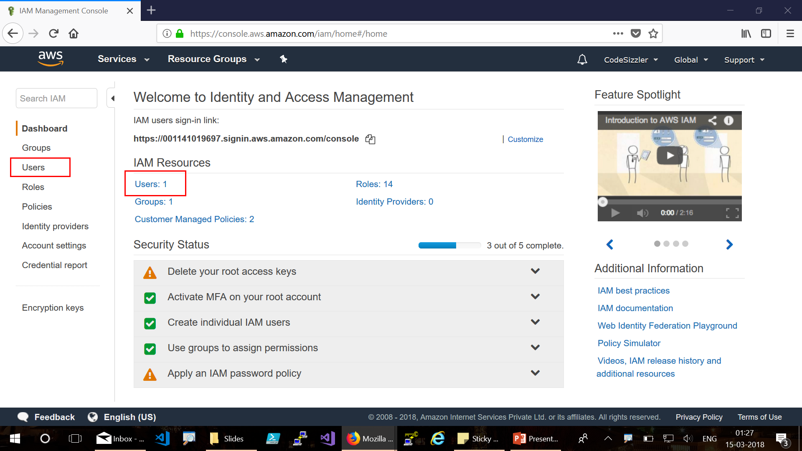
Users

Slide 7
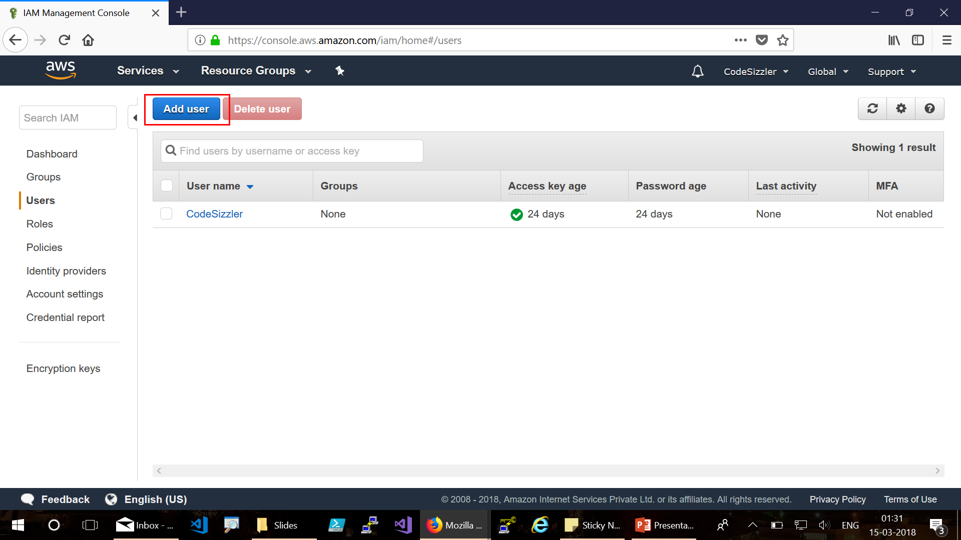

Slide 8
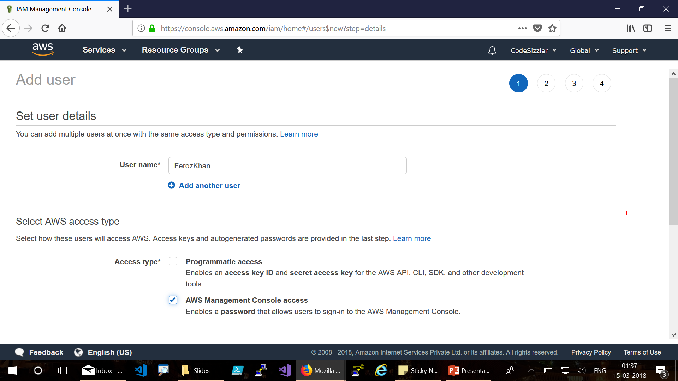

Slide 9
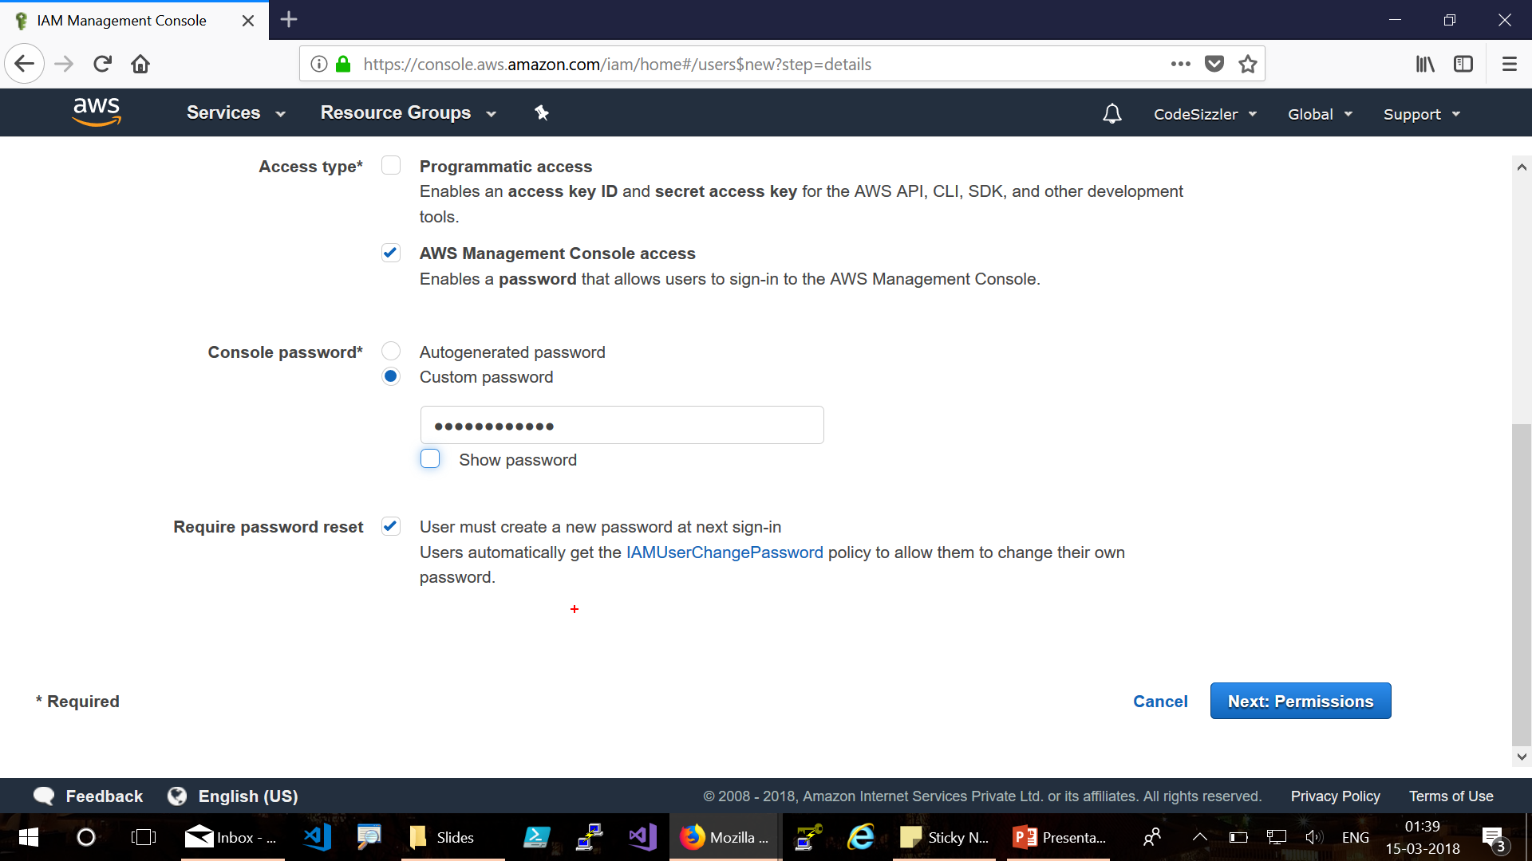

Slide 10
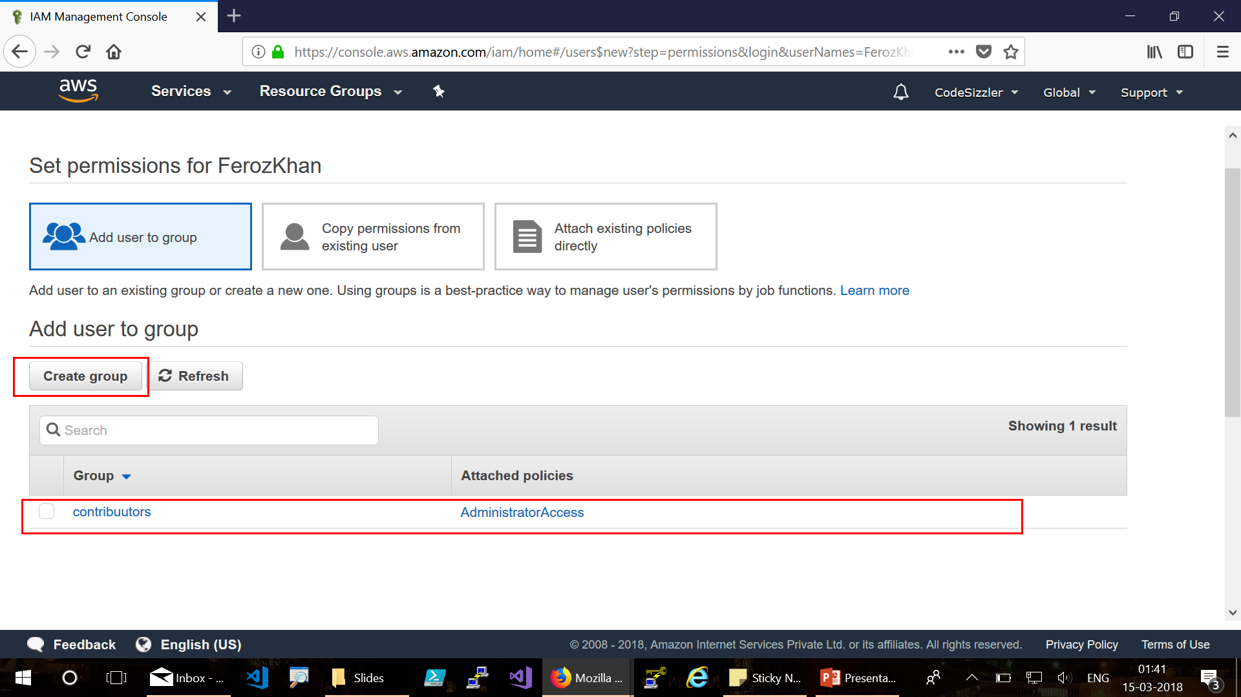

Slide 11
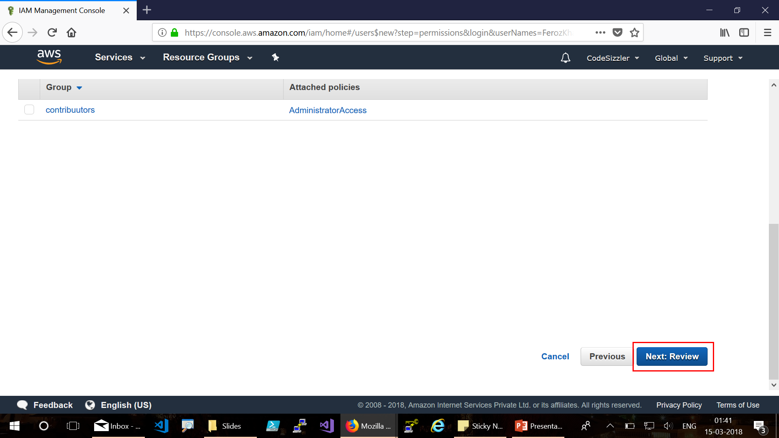

Slide 12
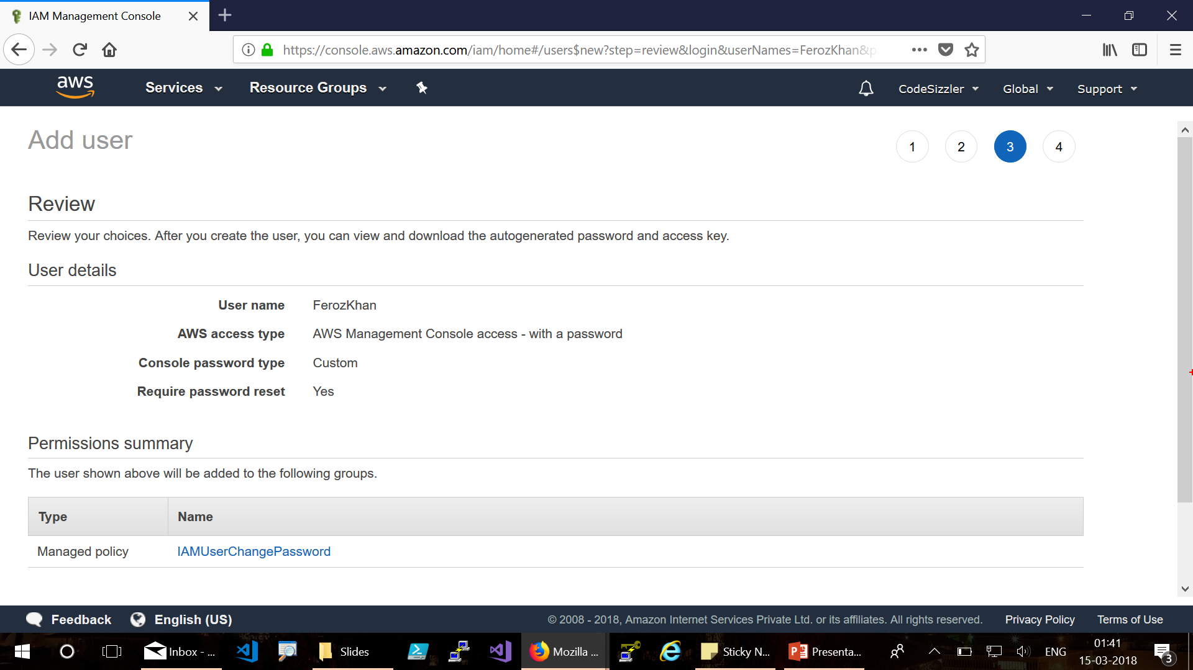

Slide 13
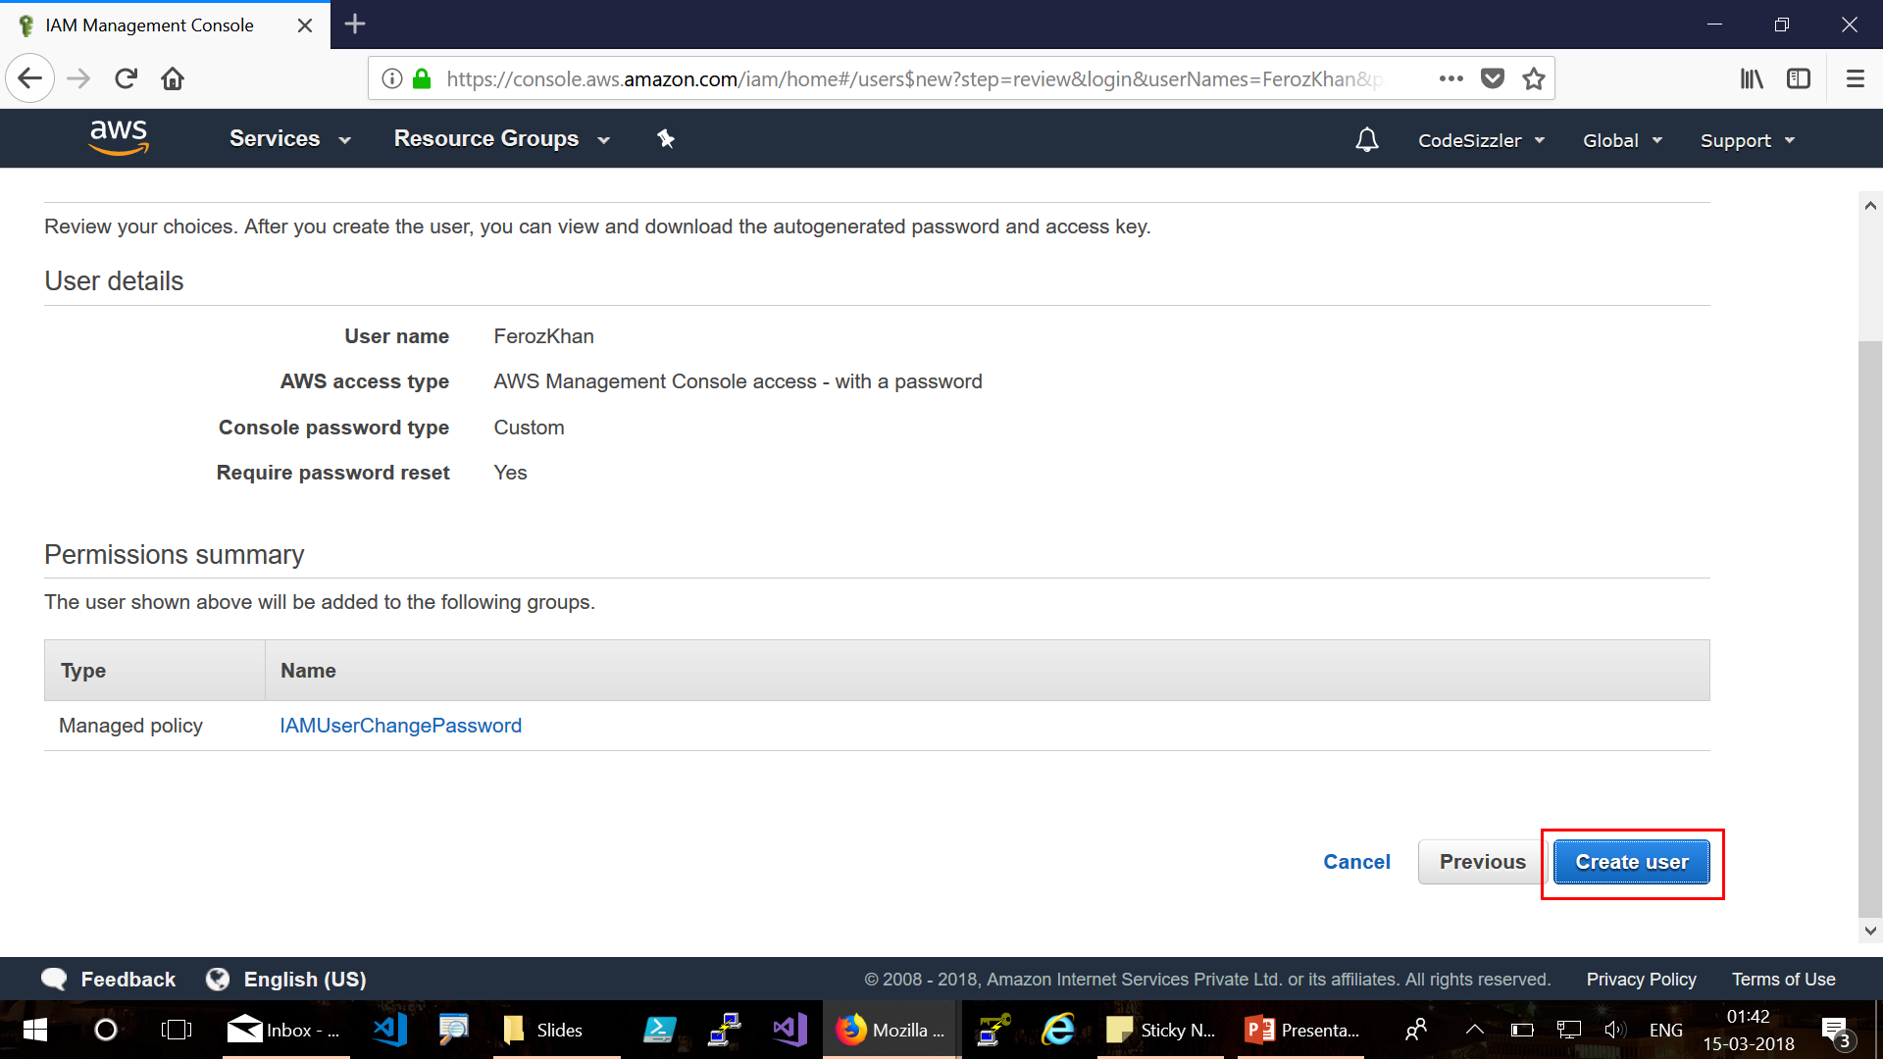

Slide 14
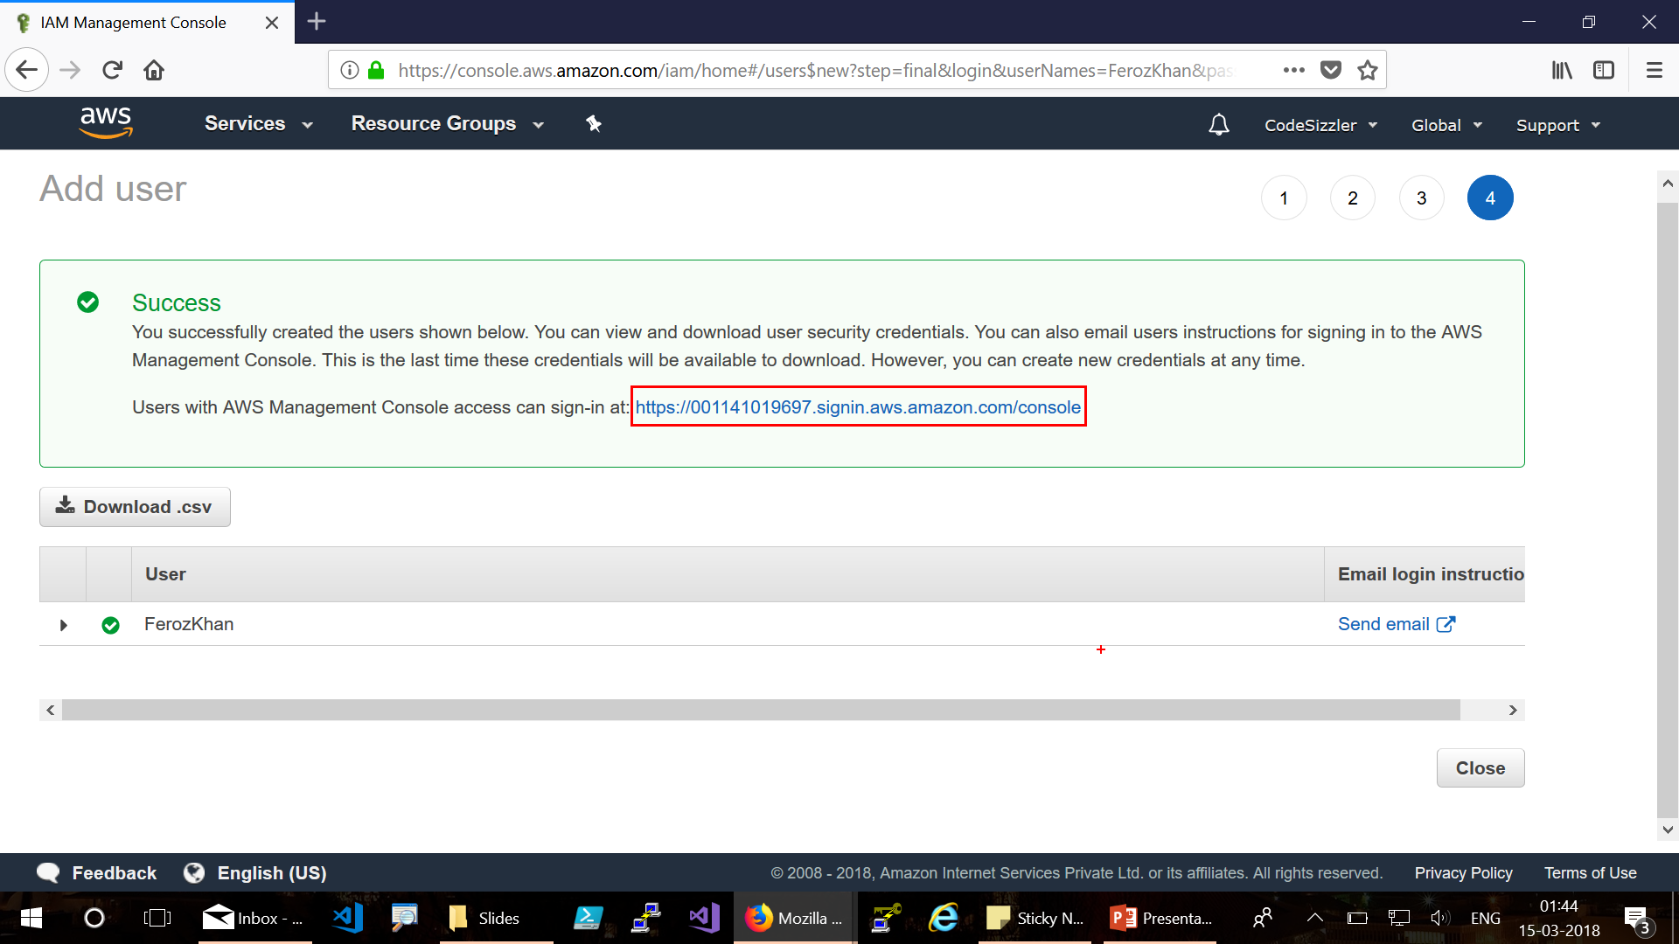

Slide 15
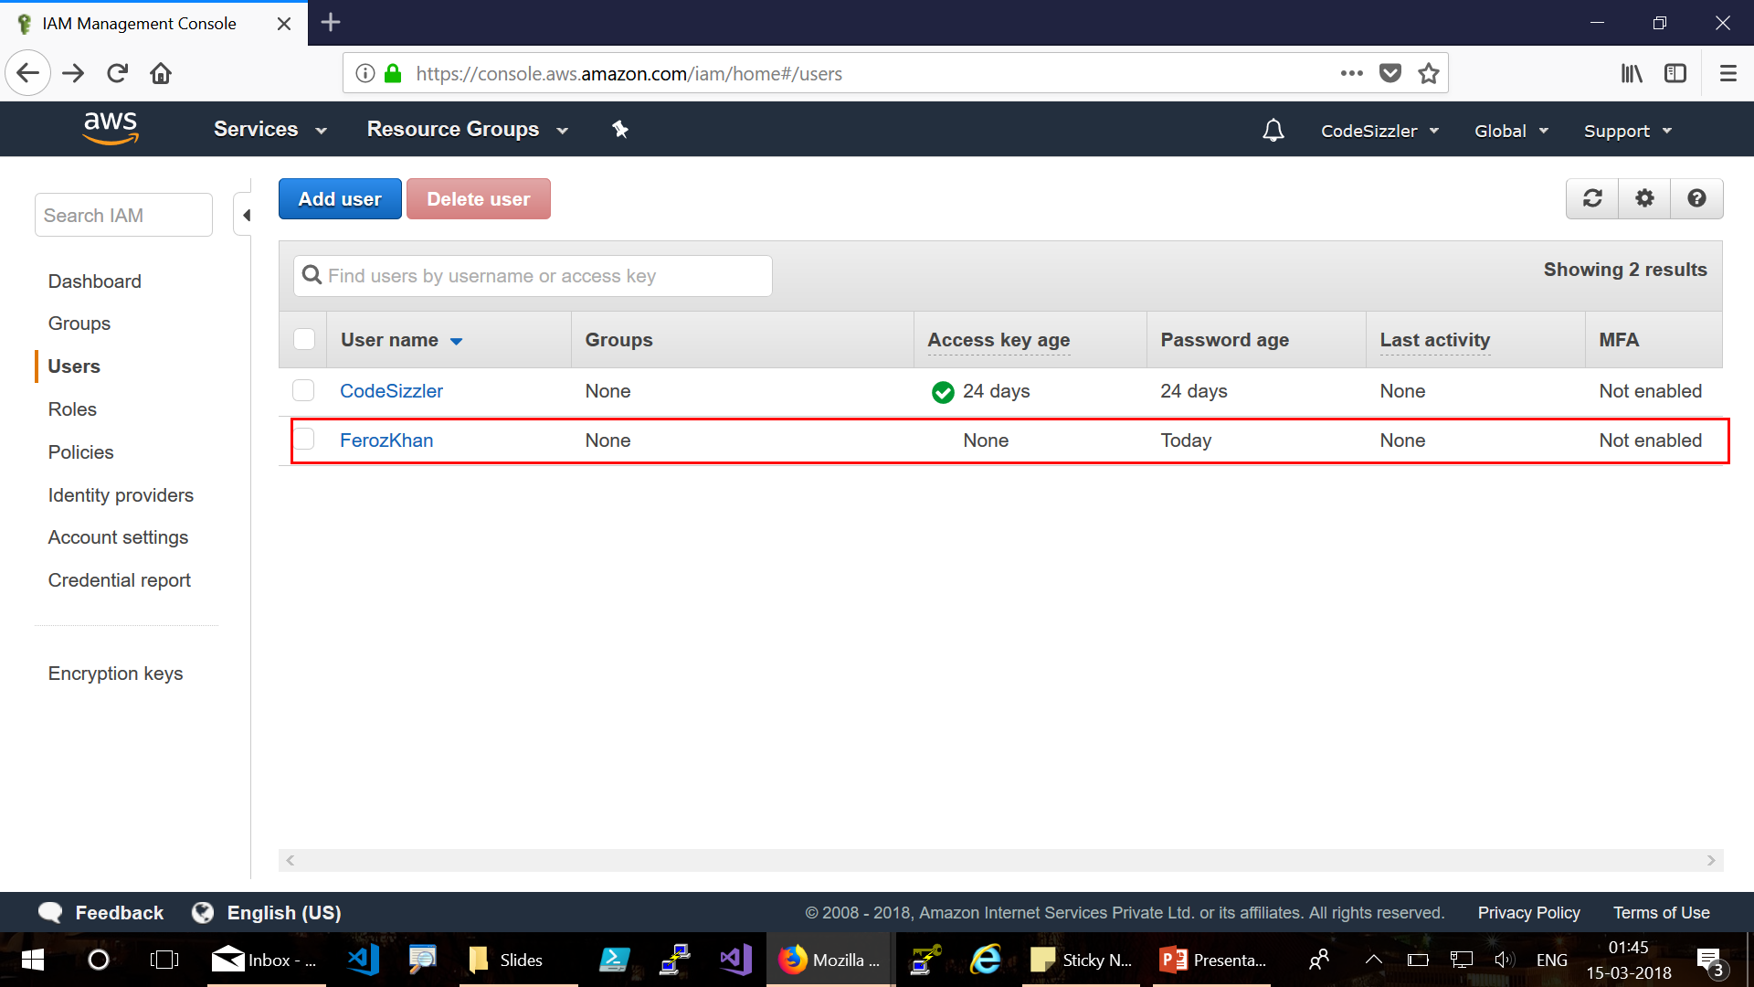

Slide 16
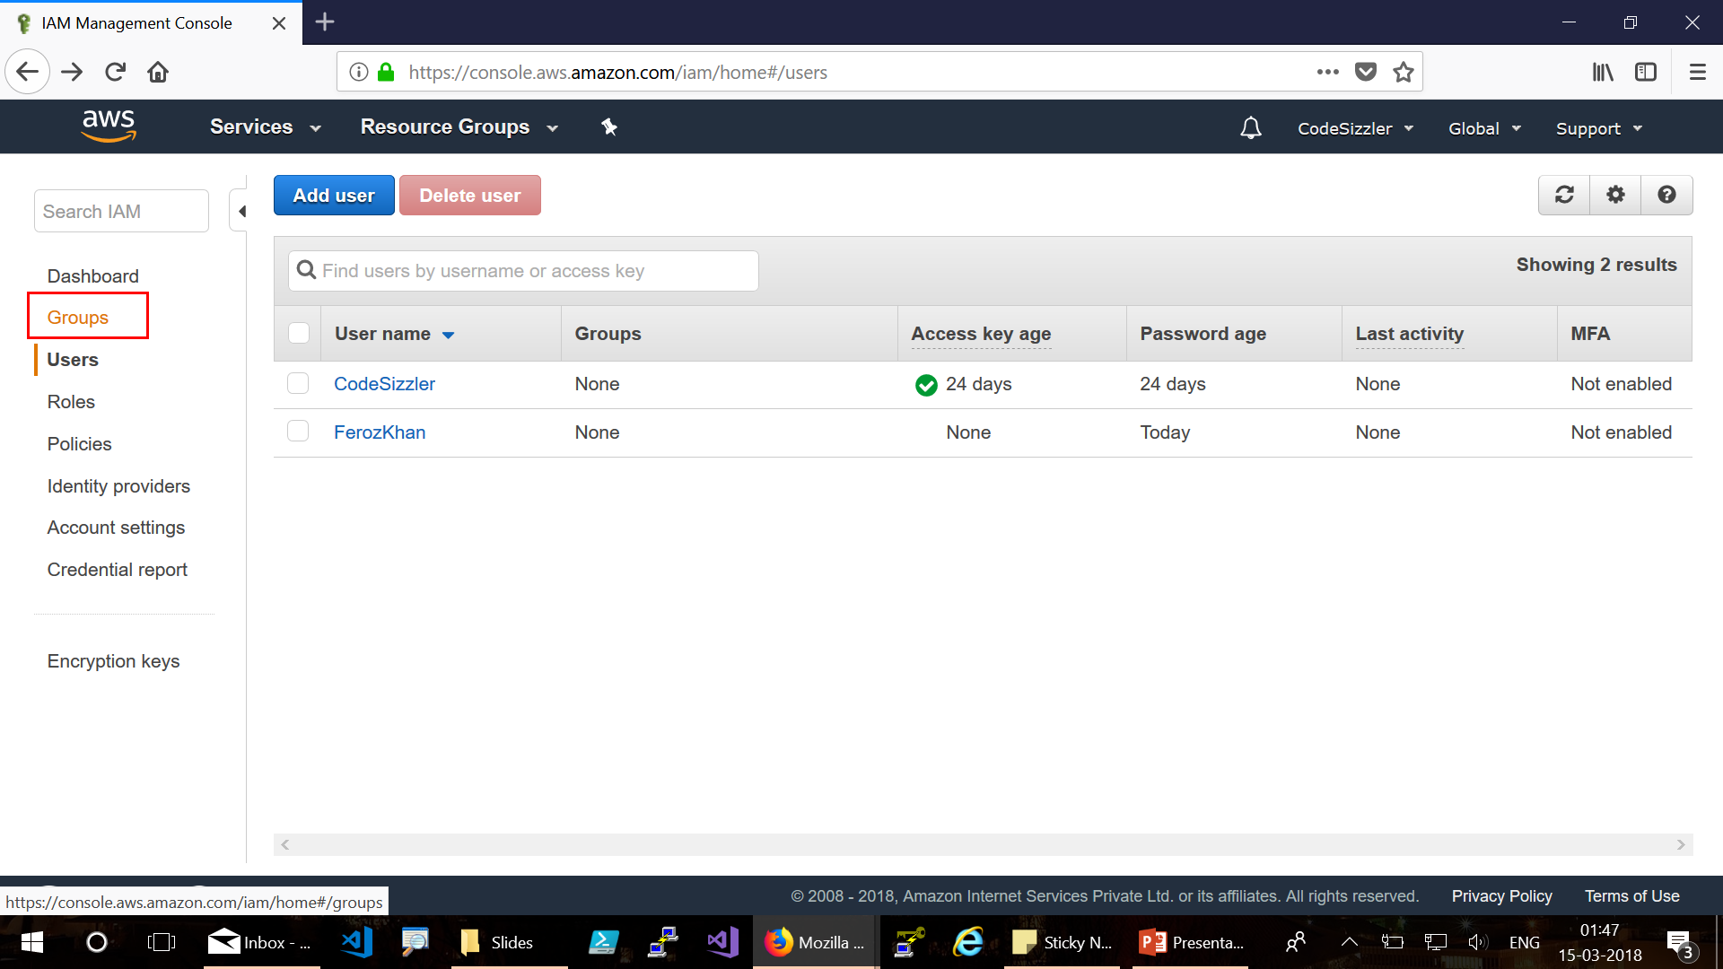
Groups:

Slide 17
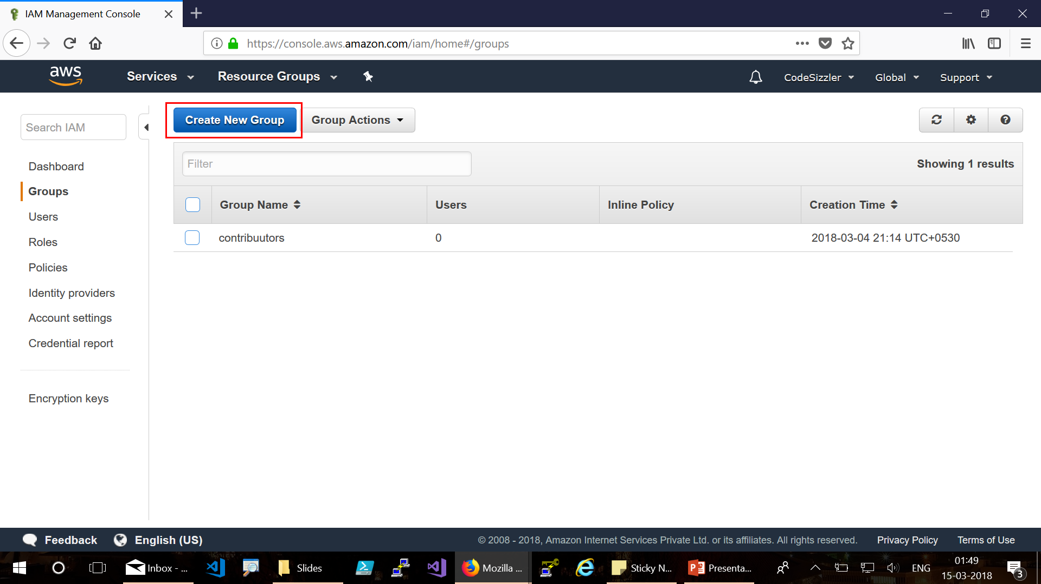

Slide 18
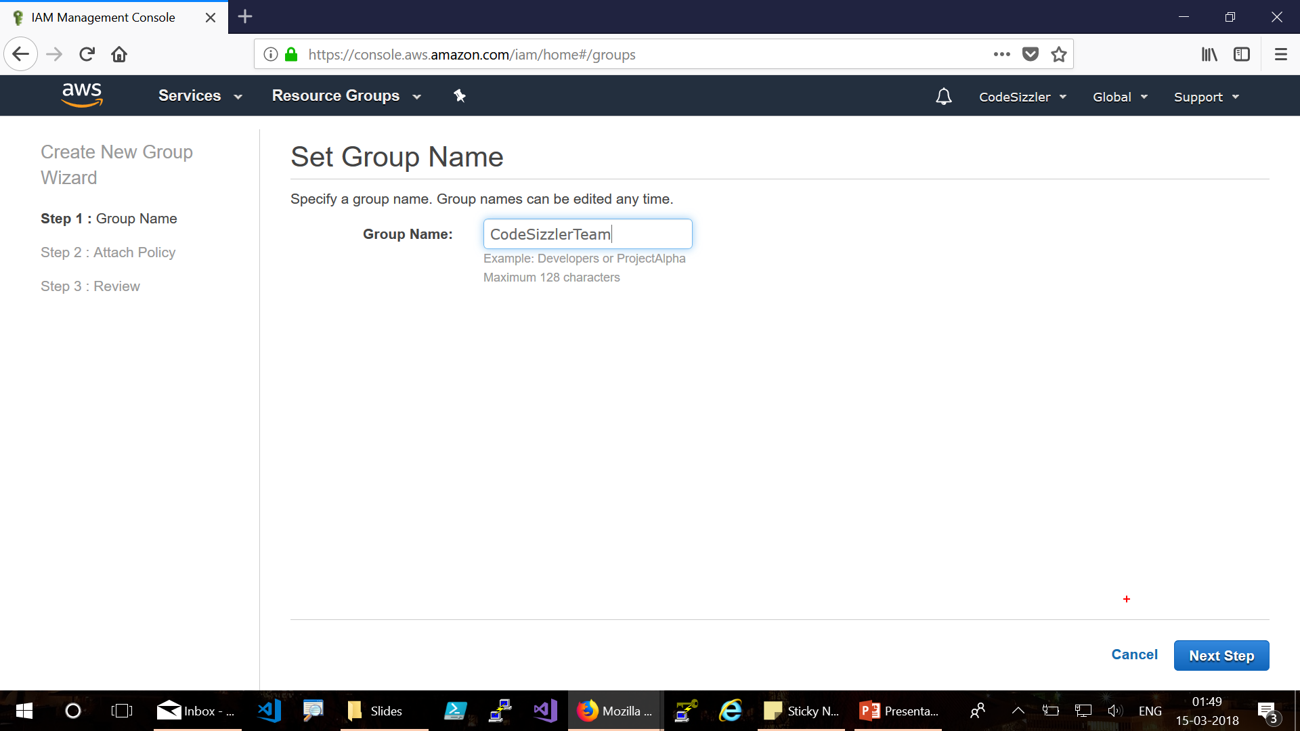

Slide 19
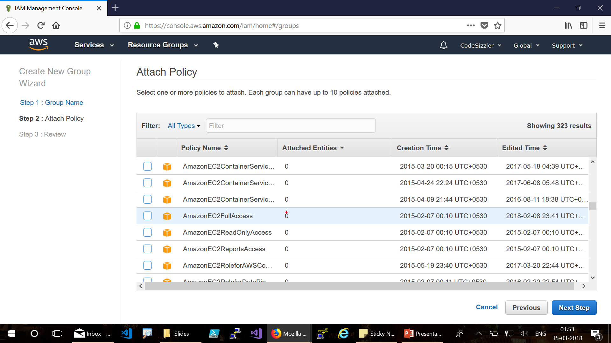

Slide 20
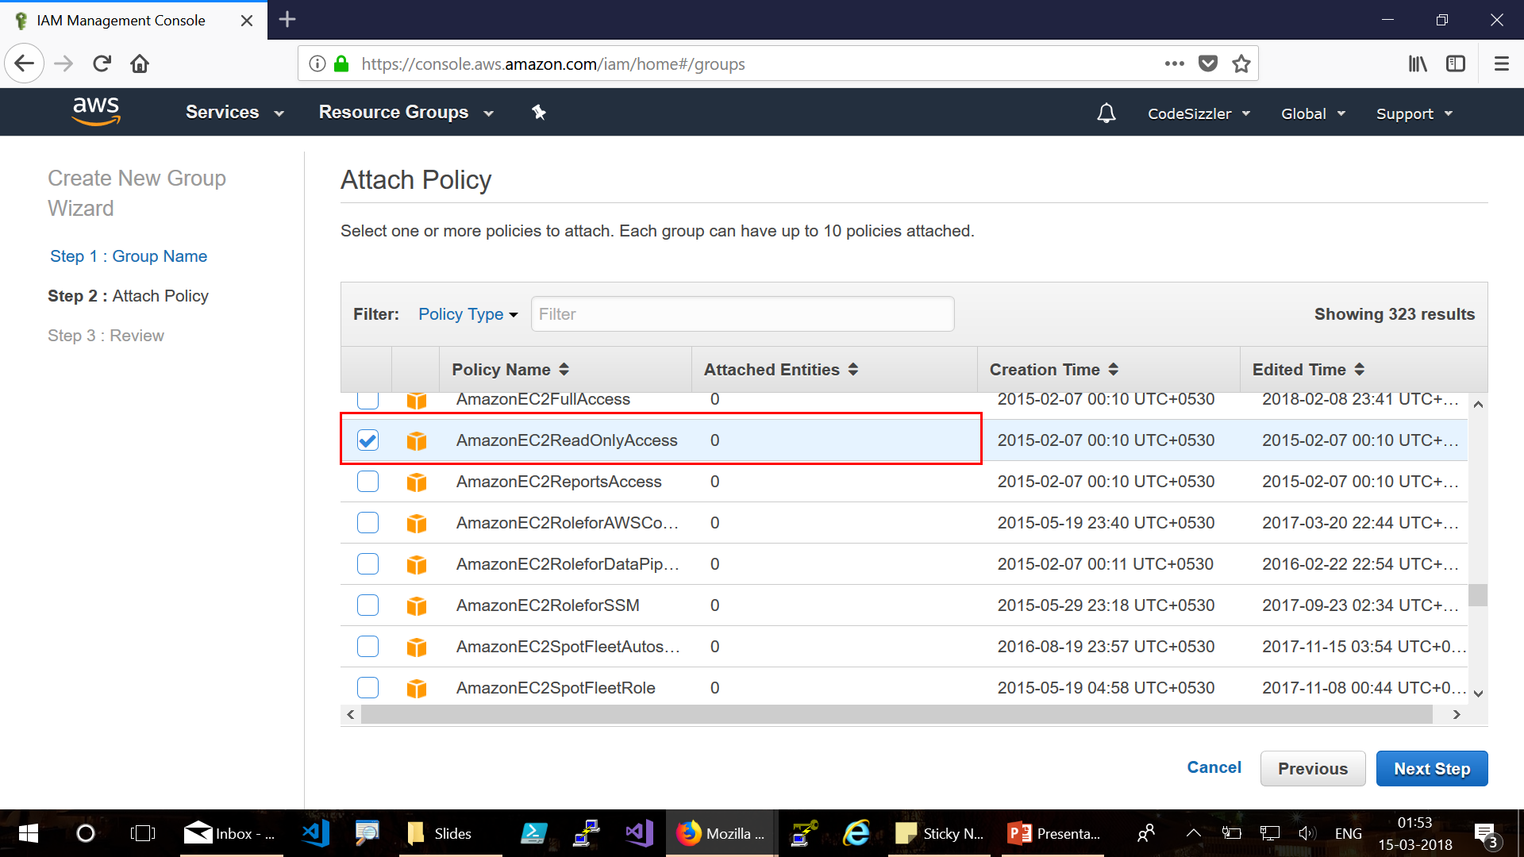

Slide 21
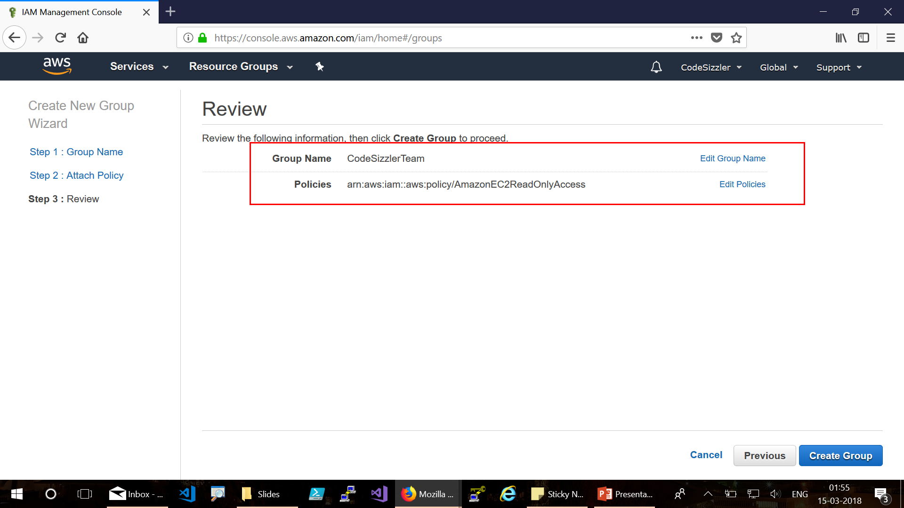

Slide 22
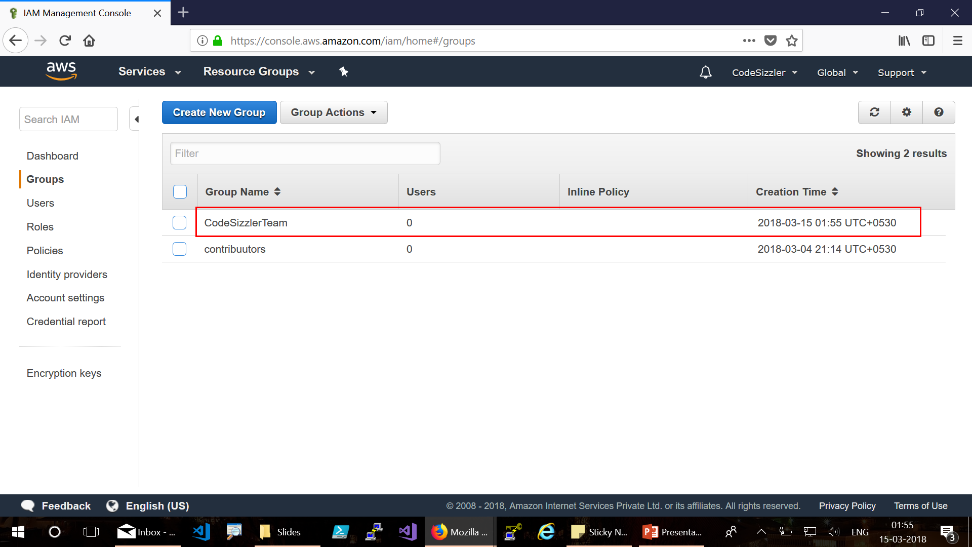

Slide 23
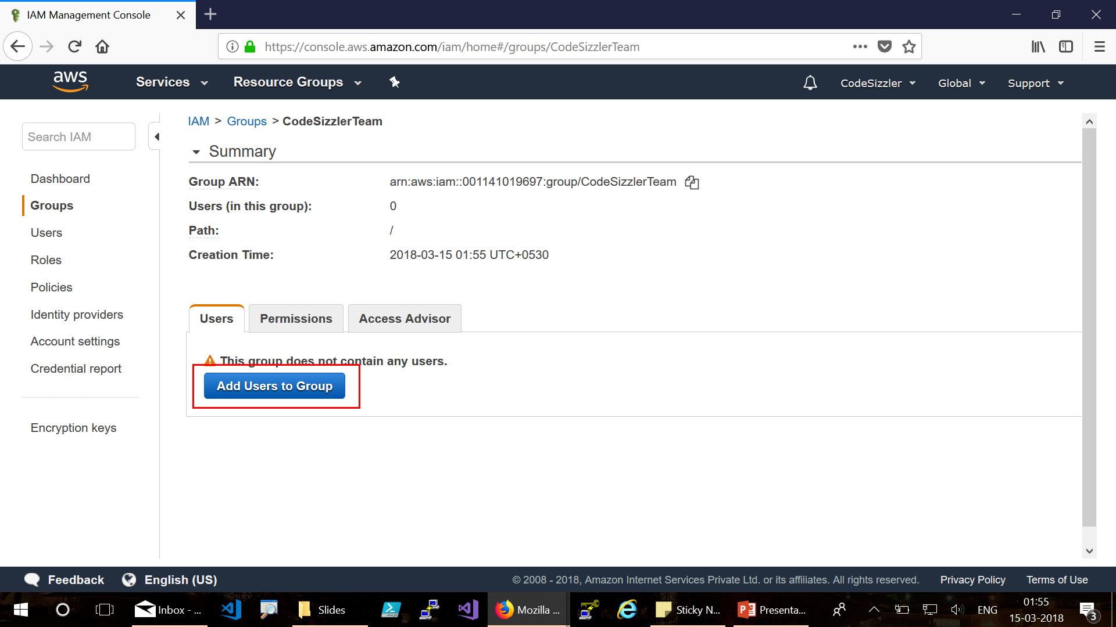

Slide 24
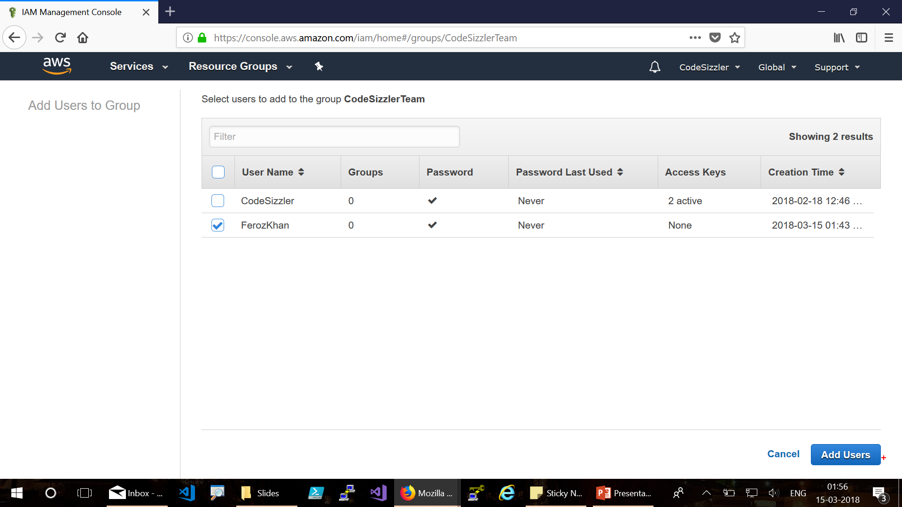

Slide 25
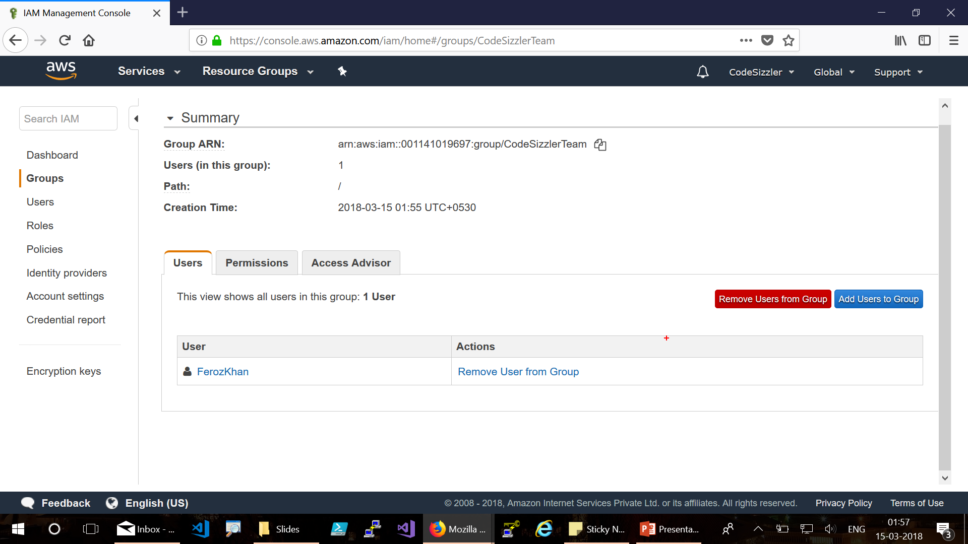

Slide 26
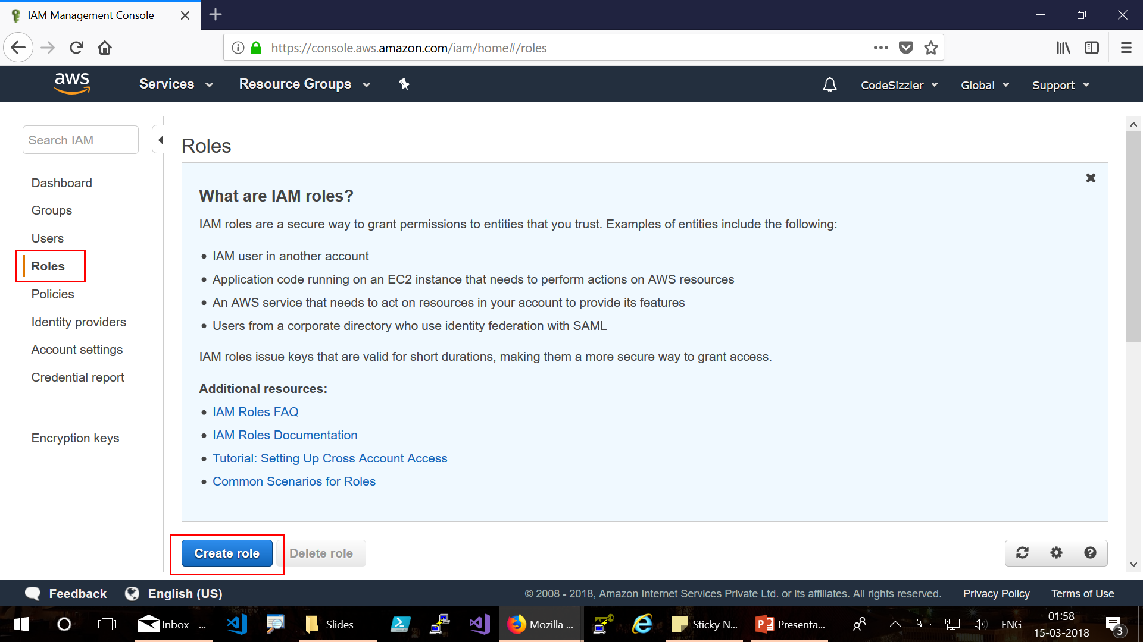
Roles

Slide 27
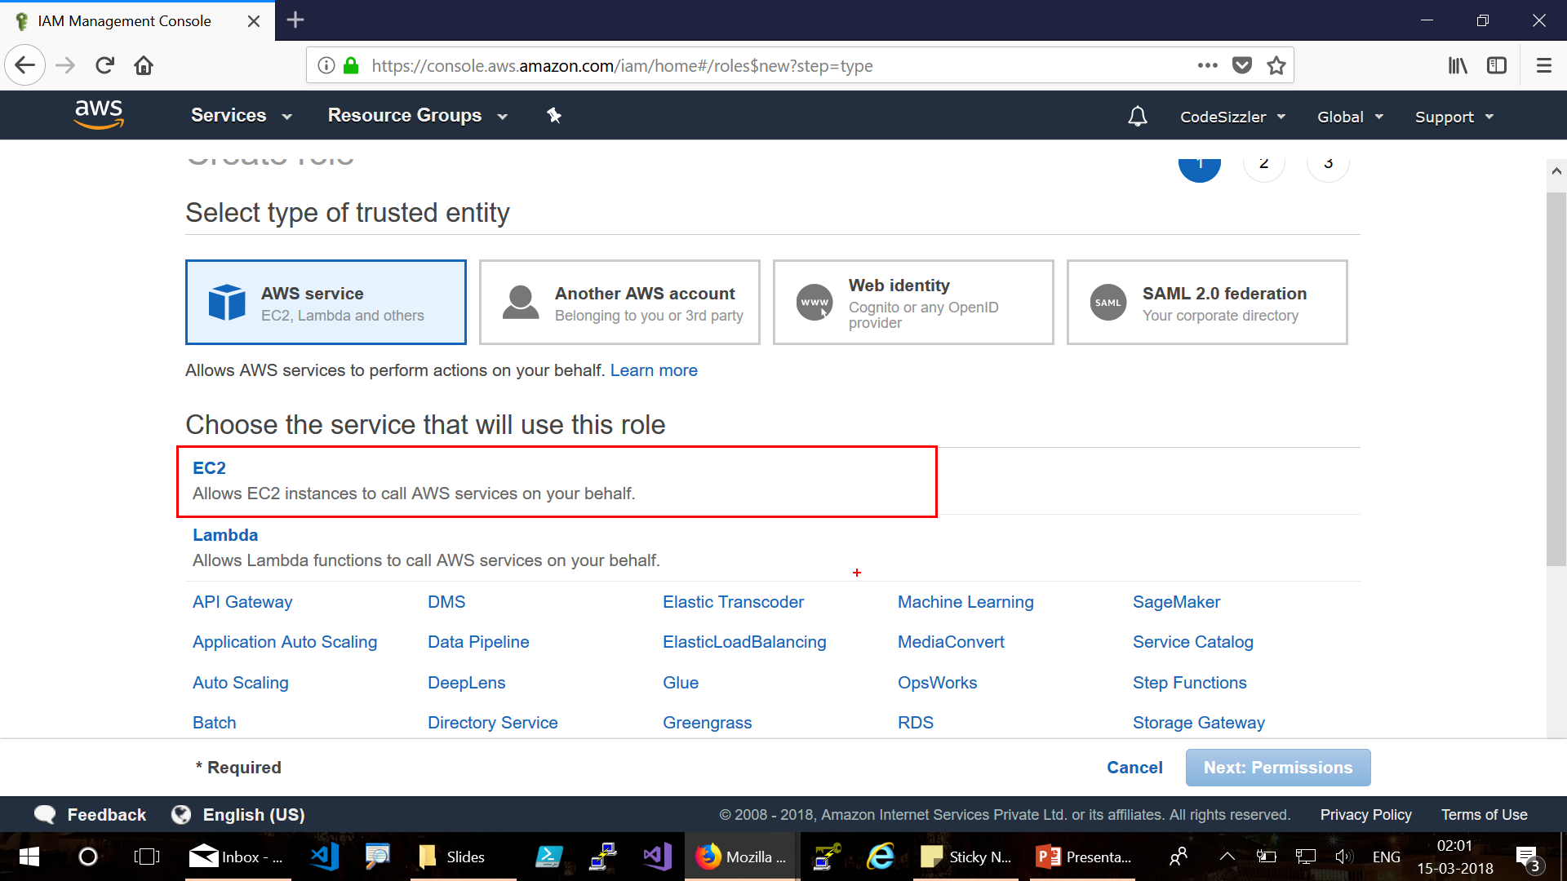

Slide 28
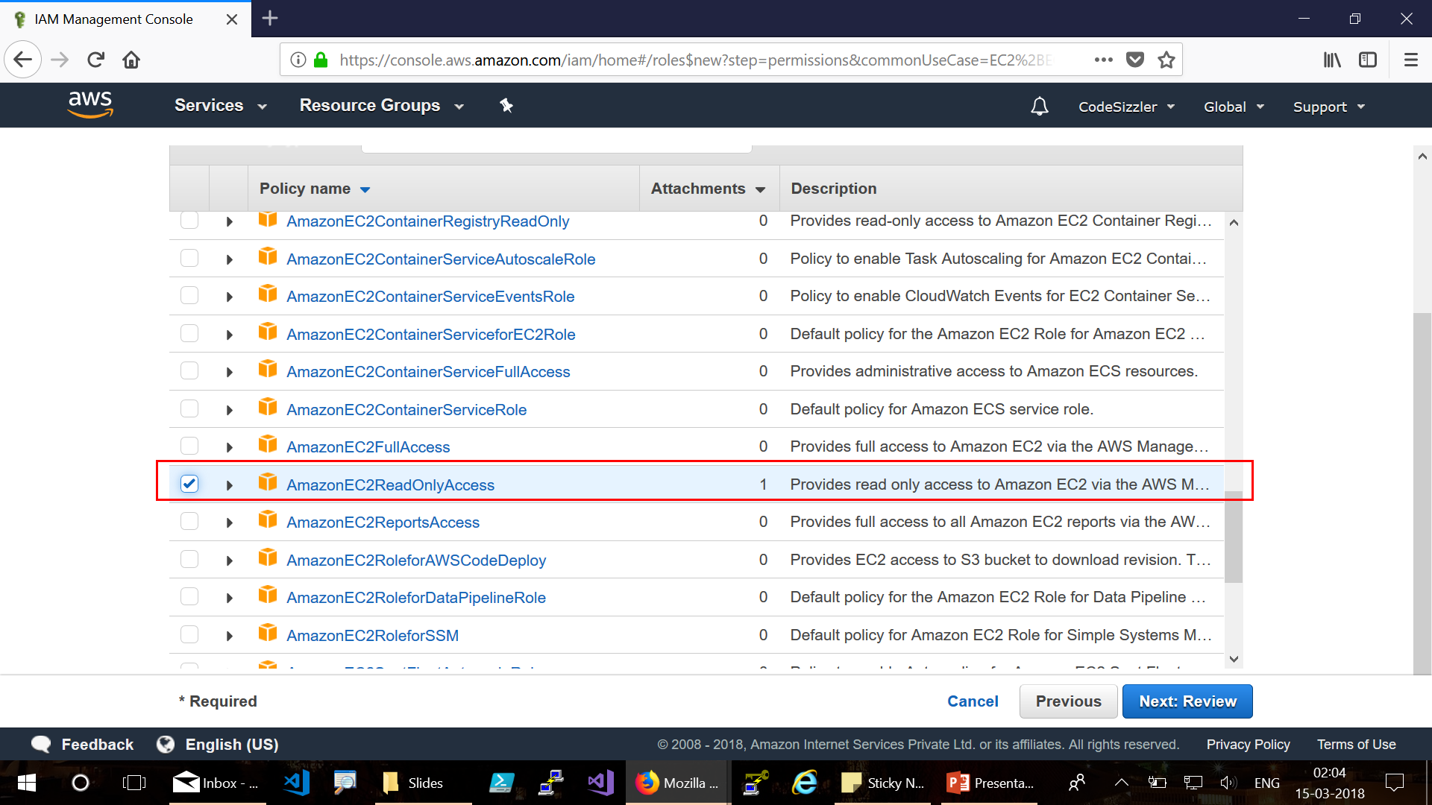

Slide 29
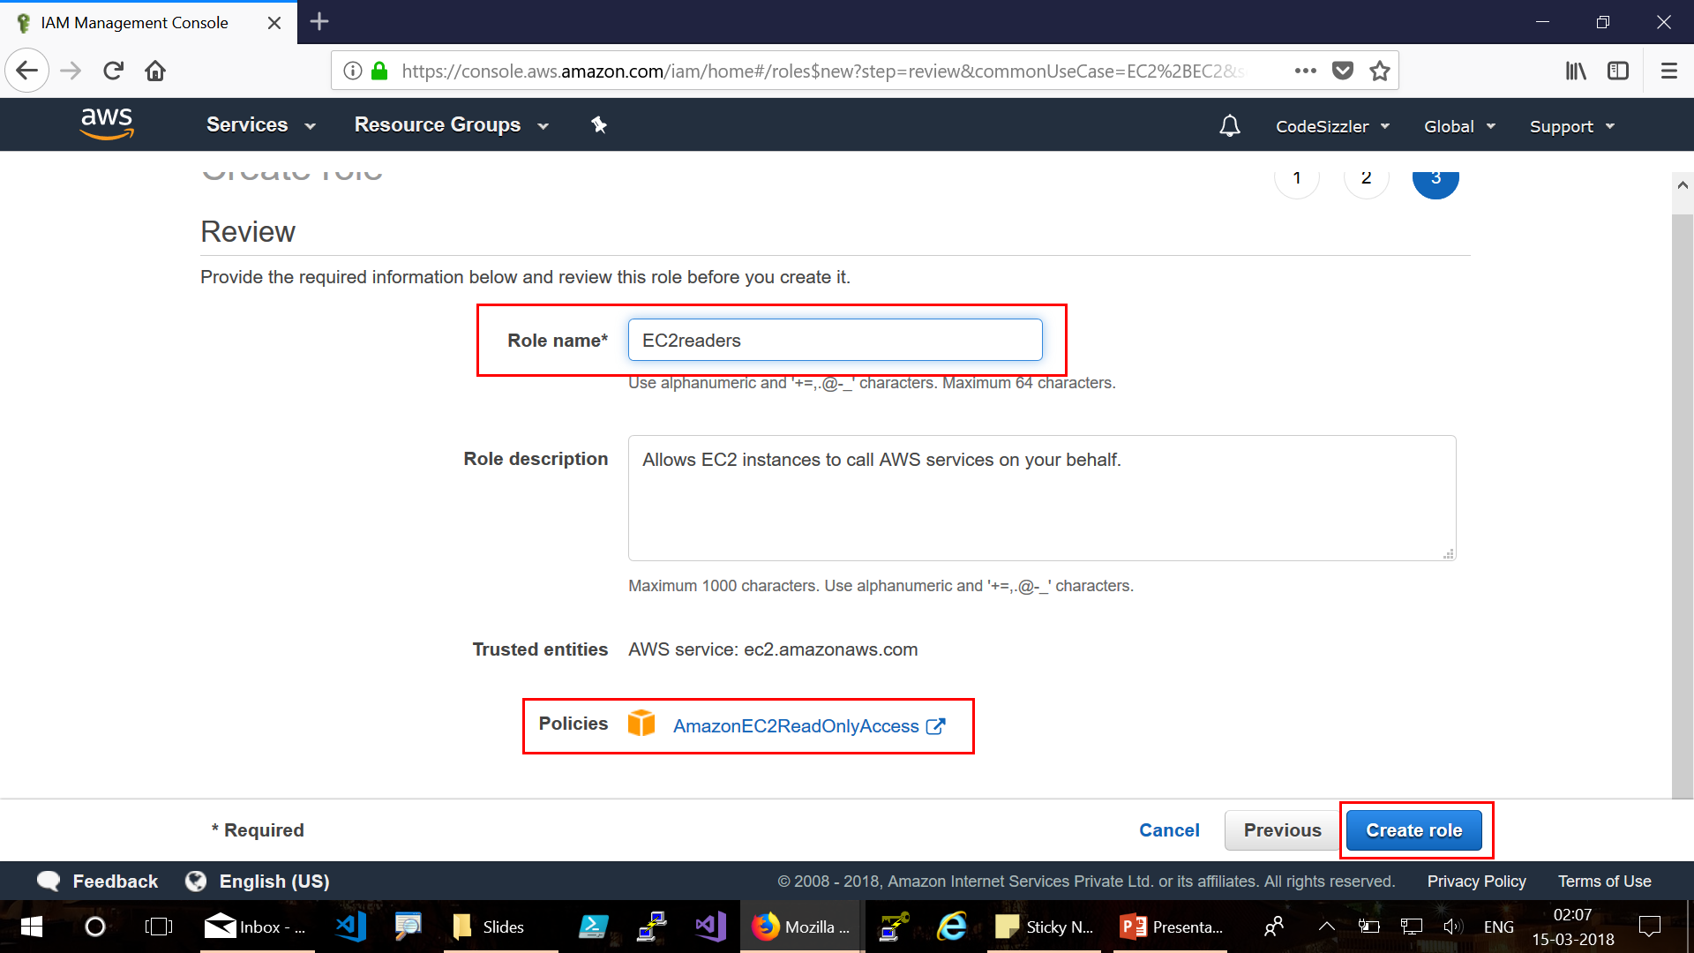

Slide 30
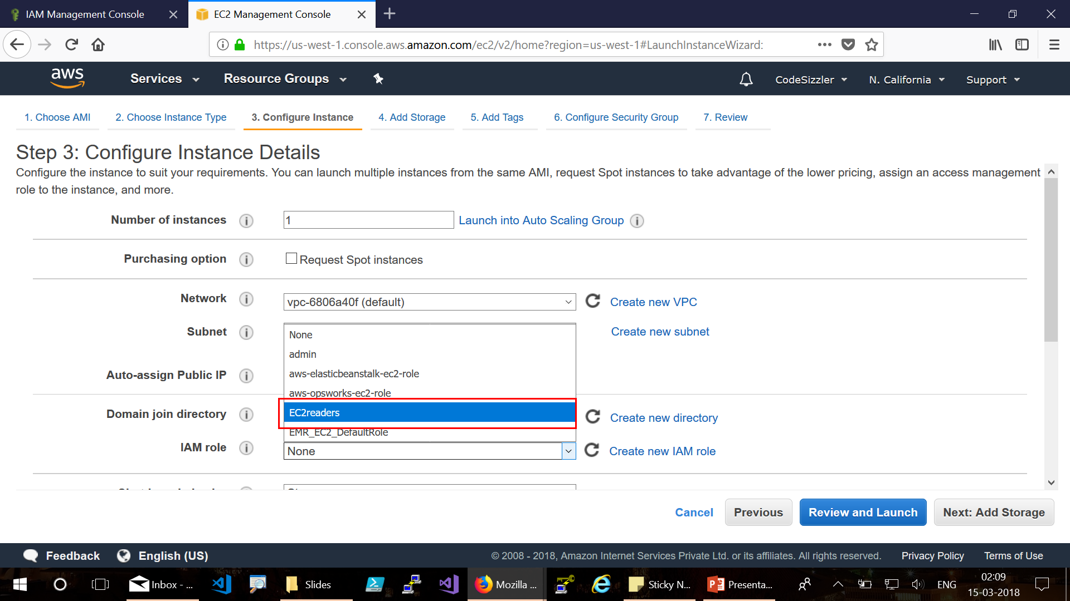

Slide 31
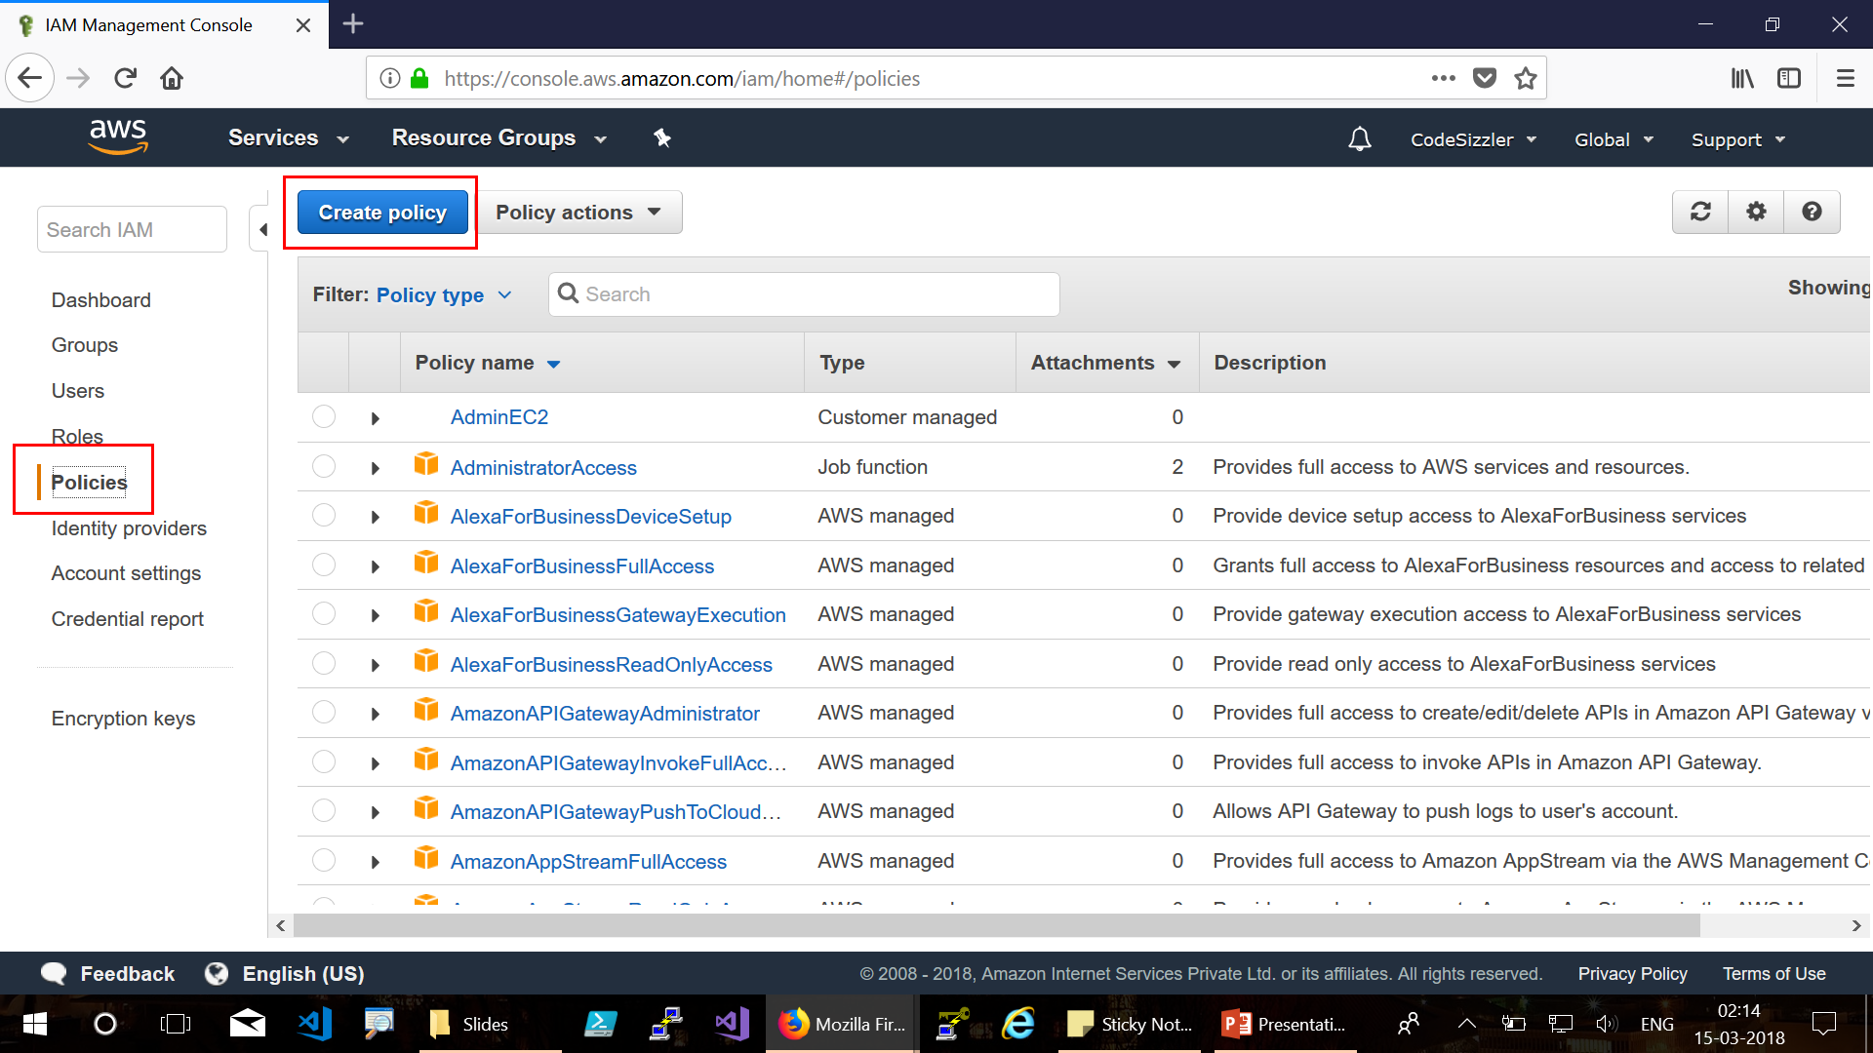
IAM Policies

Slide 32
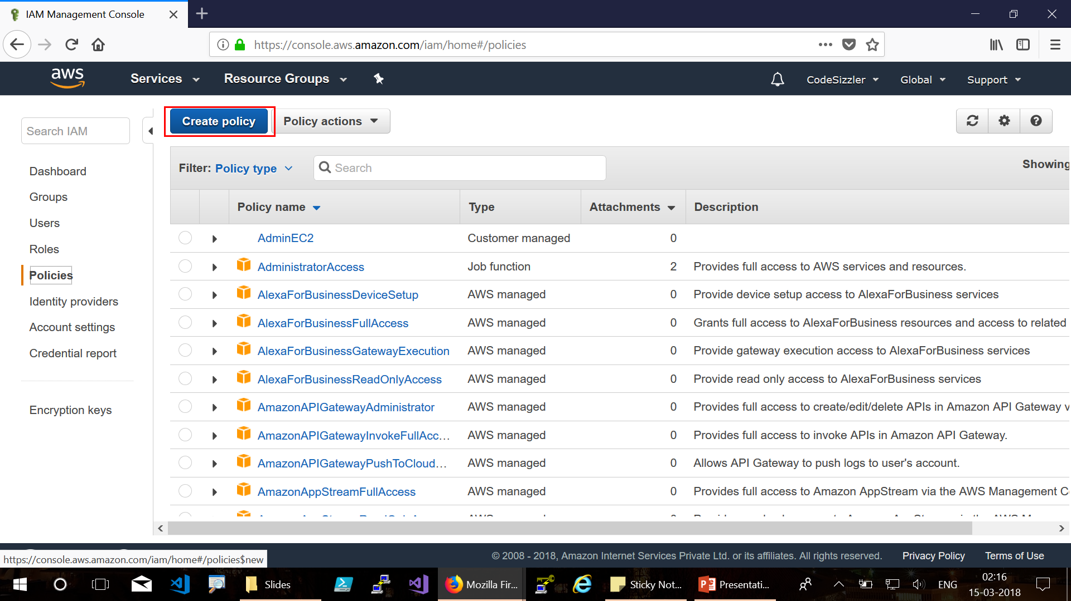

Slide 33
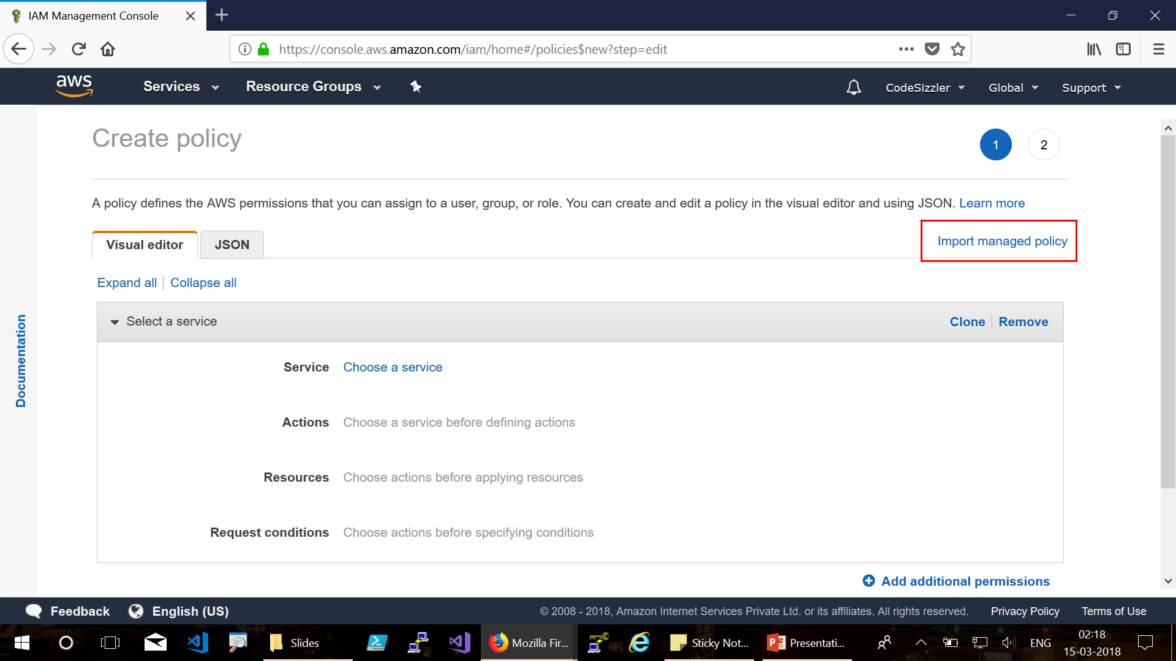

Slide 34
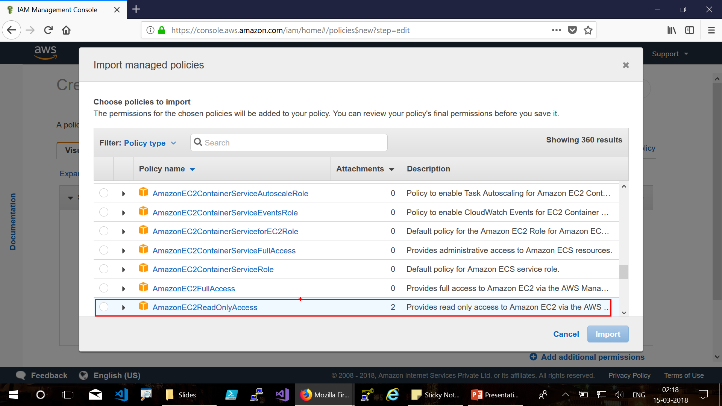

Slide 35
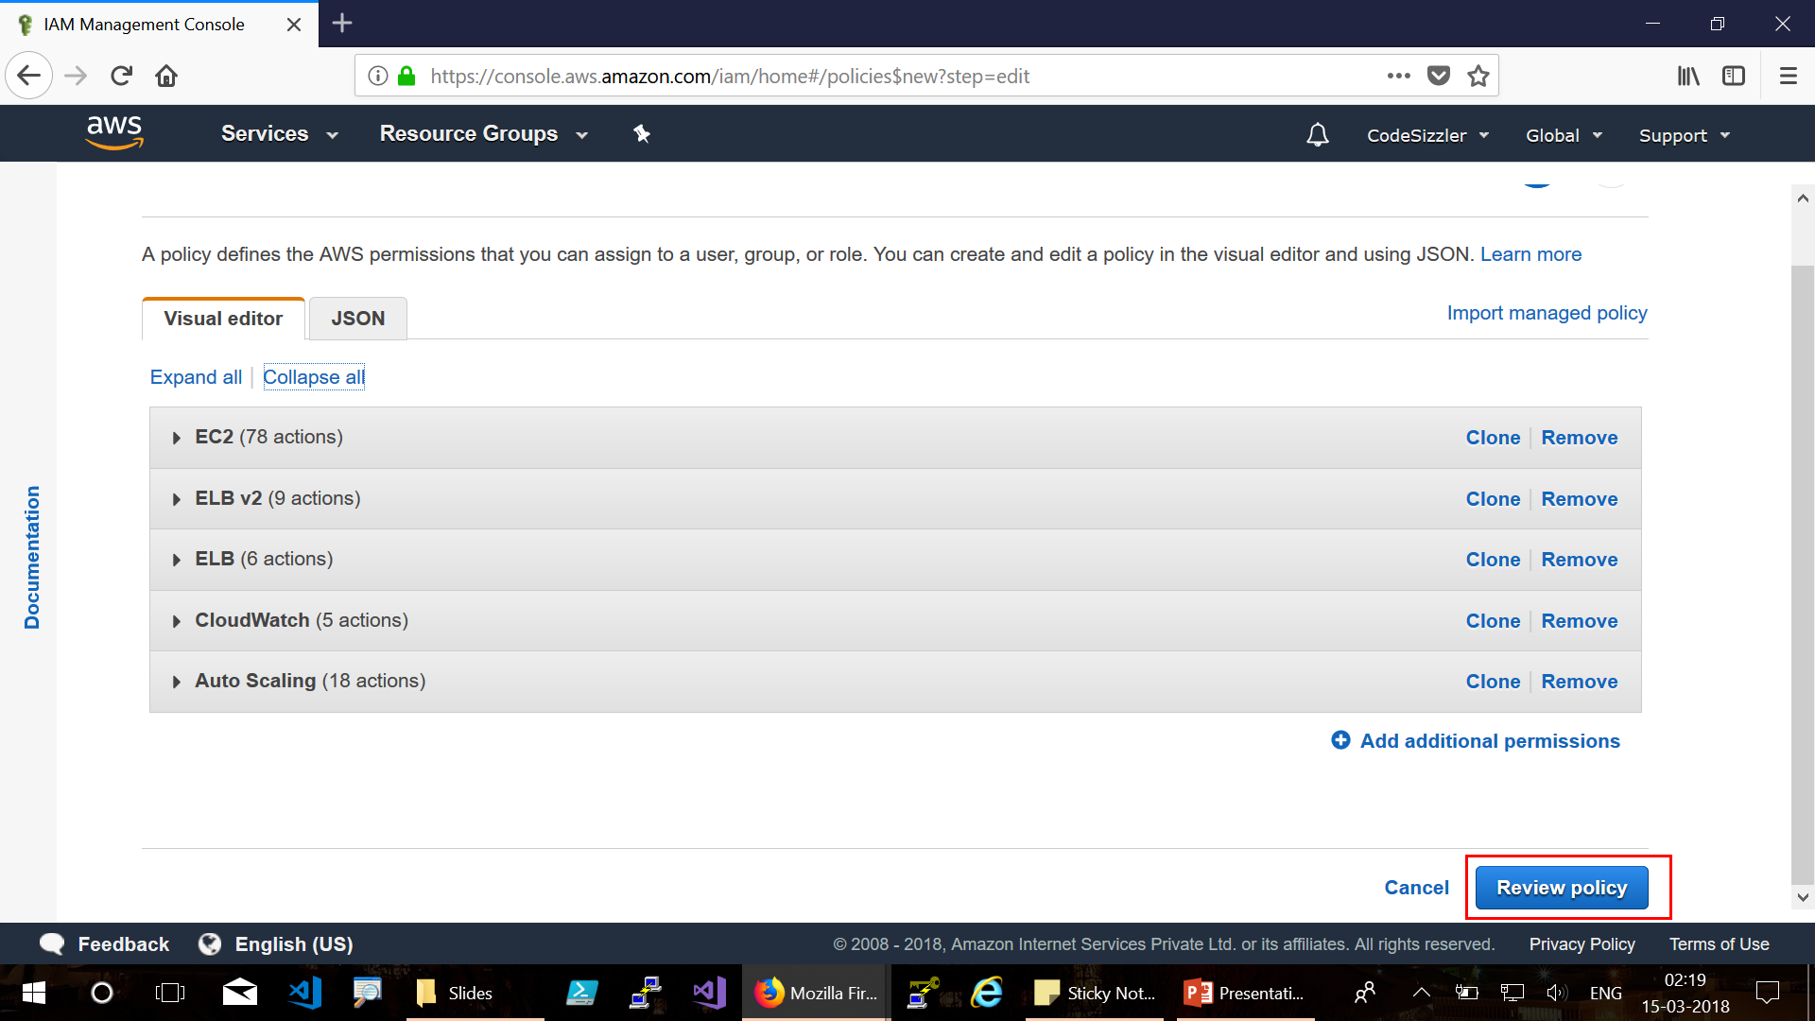

Slide 36
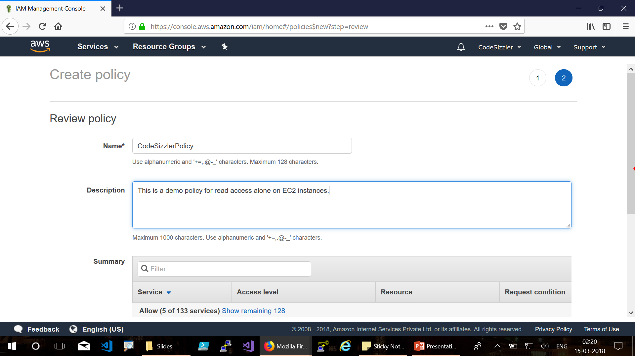

Slide 37
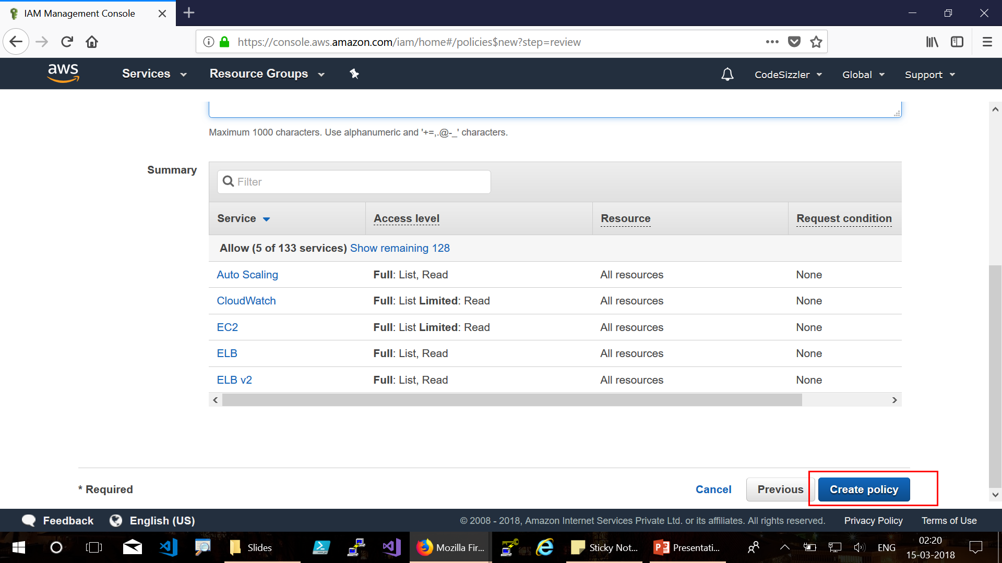

Slide 38
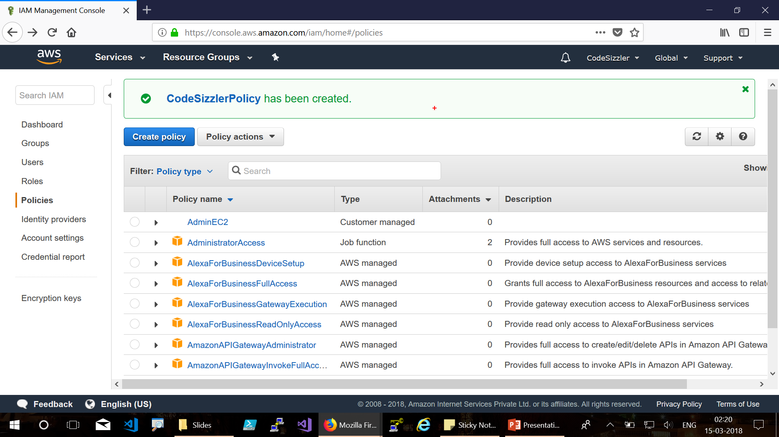

Slide 39
IAM Audit:
Why do we use IAM Audit?

Slide 40
Use cases for Audit in IAM
When should you perform an audit in IAM?
Review your IAM Users
Review your IAM Groups
Review your IAM Roles
Review your Mobile Apps
Review your EC2 instances

Slide 41
AWS CloudTrail:
Actions taken by a user, role, or an AWS service are recorded as events in CloudTrail

Slide 42
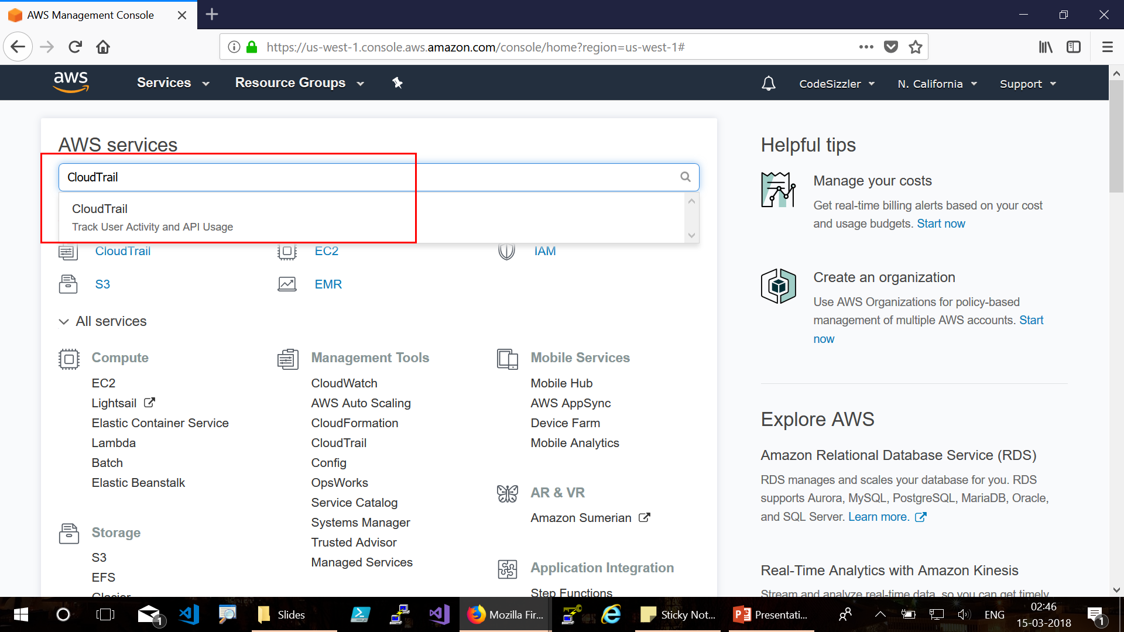

Slide 43
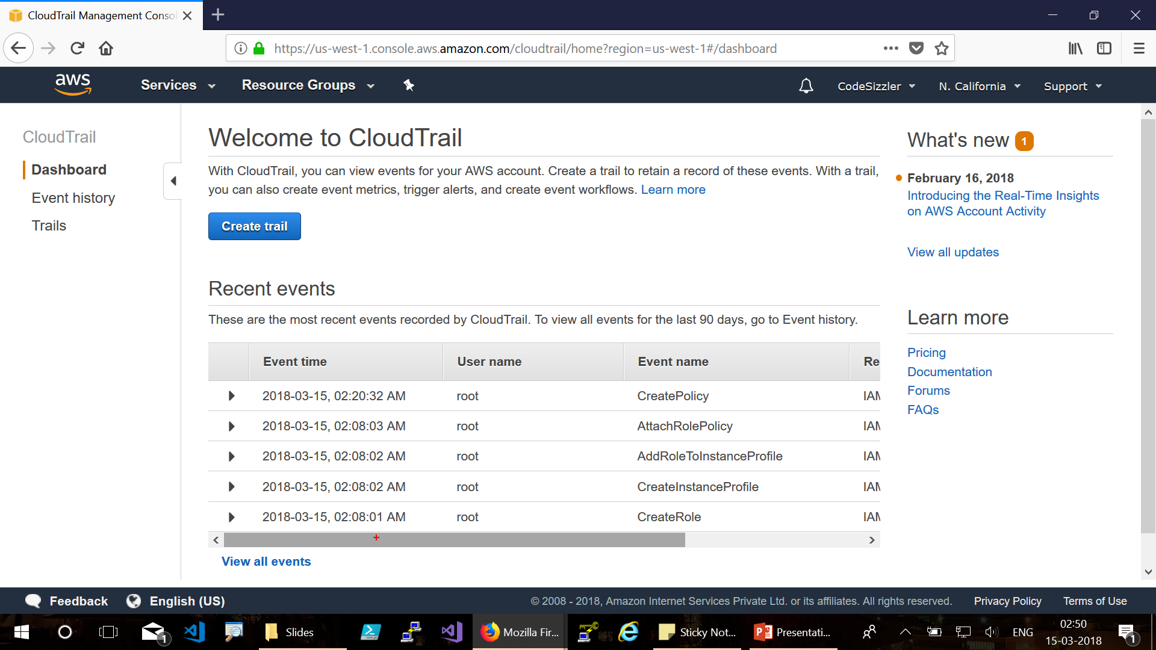

Slide 44
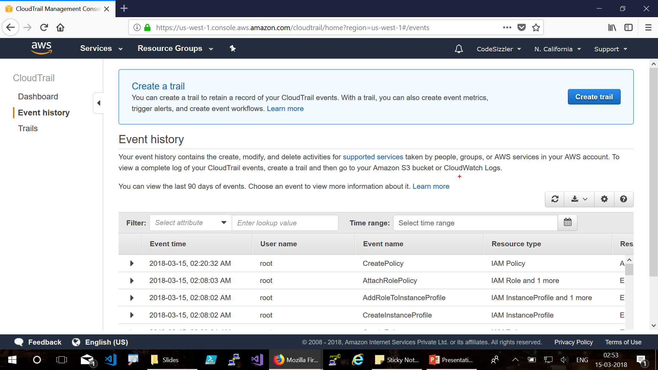
Event History

Slide 45
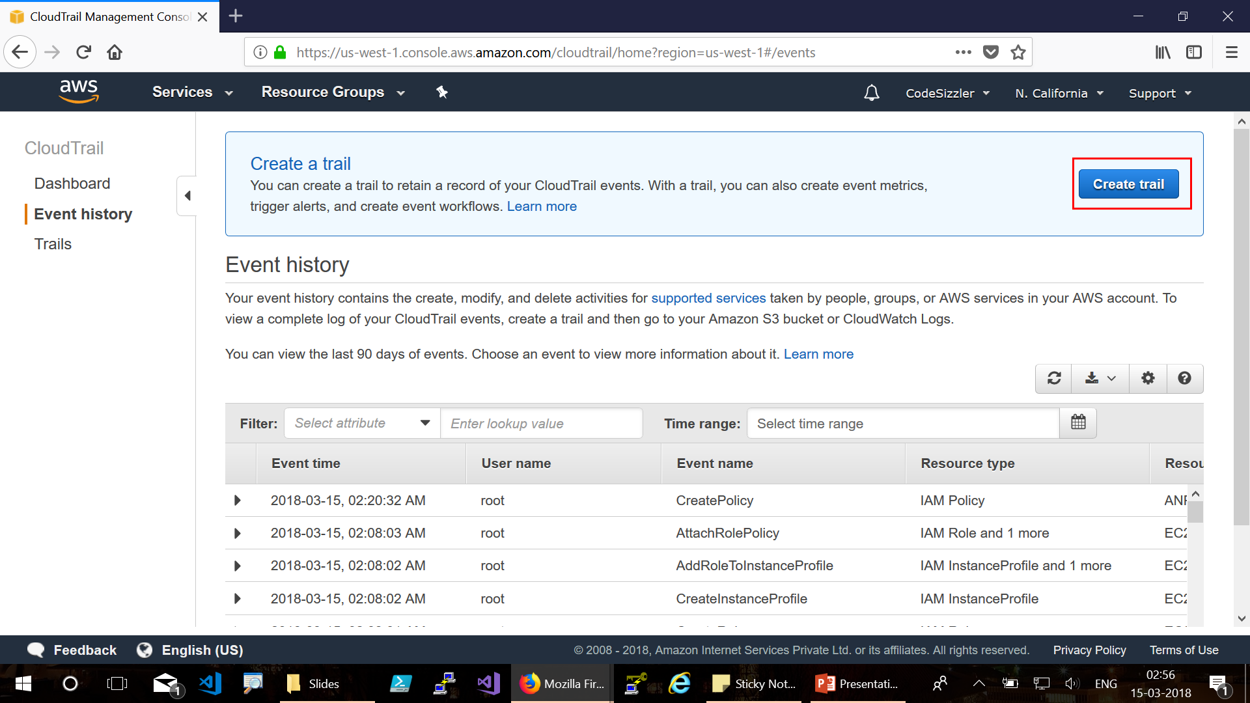

Slide 46
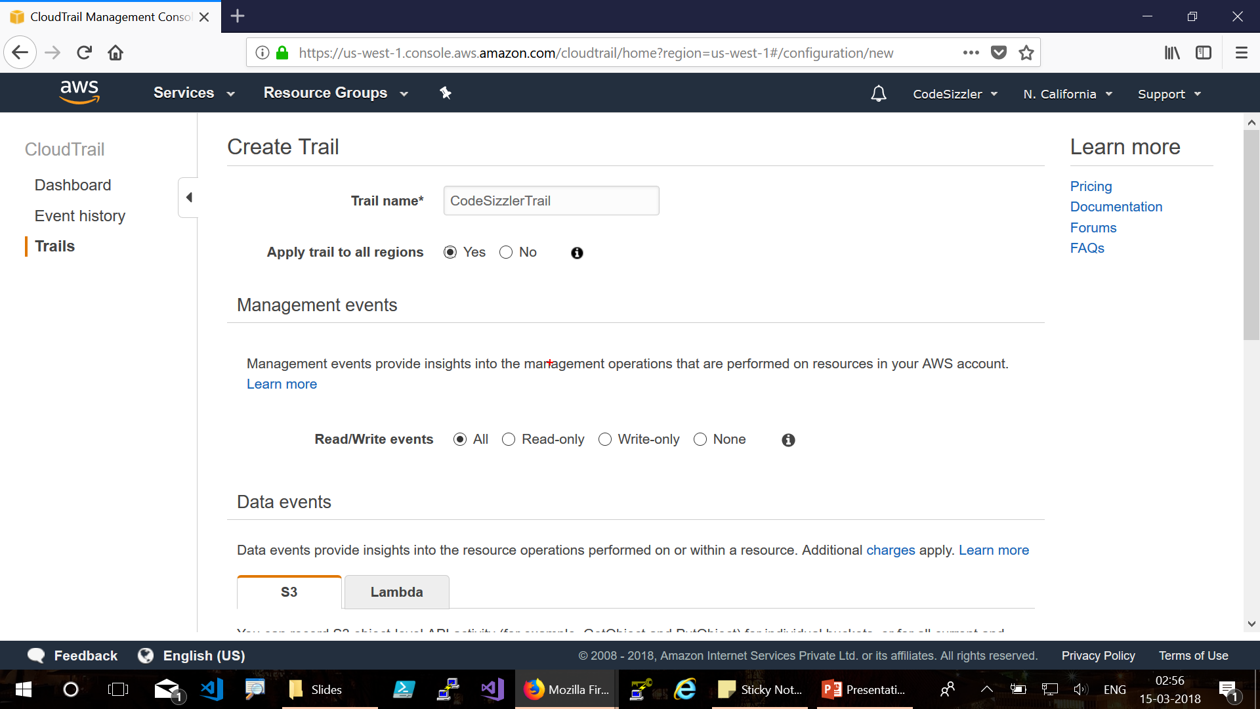

Slide 47
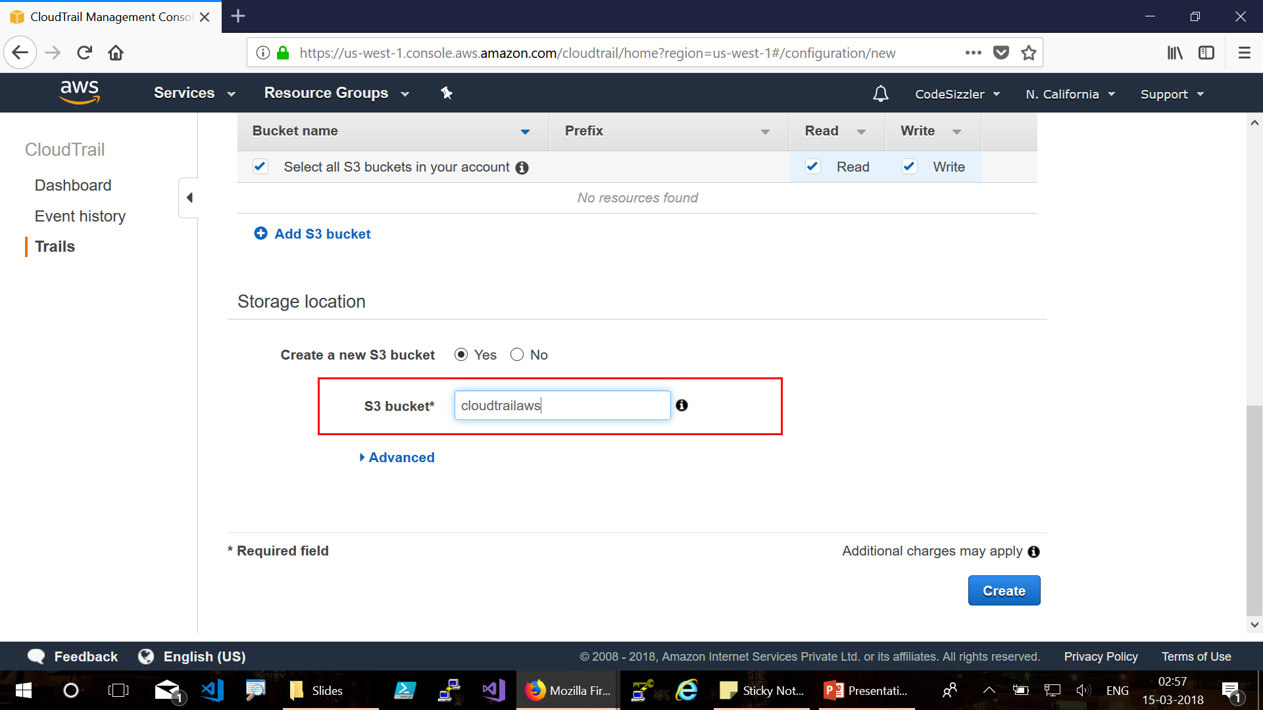

Slide 48
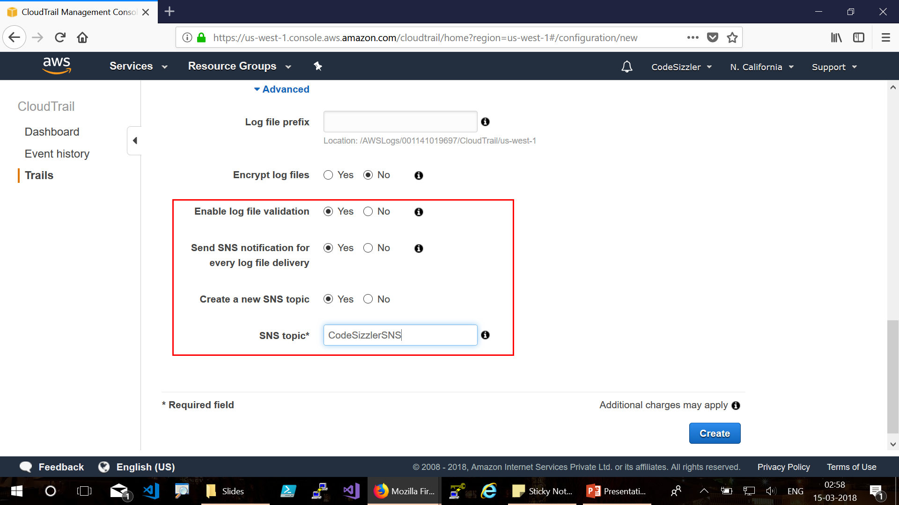

Slide 49
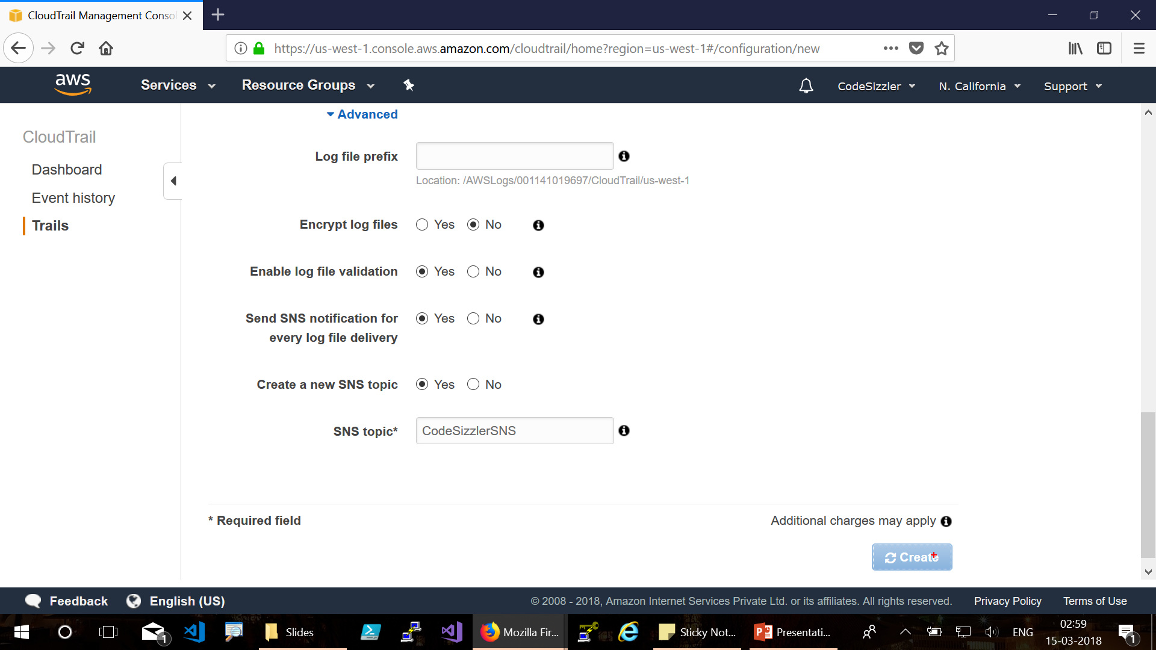

Slide 50
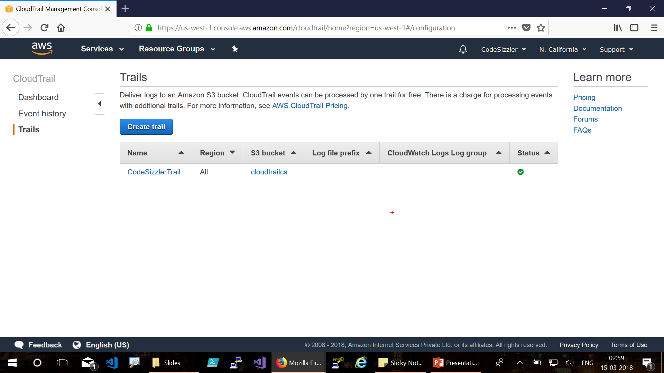

Slide 51

For queries reach us @ codesizzler@outlook.com
Twitter - @TechFero | @CodeSizzler

